Slide 1
The Limit Point
A Presentation by
Chris Hood

Slide 2
House Rules
Security – Passes – Sign in / out
Fire Alarms – Escape Route - Fire Point
Non Smoking Site
Refreshments
W C
Mobile Telephones
Notes:
Passes must be worn and visible at all times.
Fire Alarms test on Fridays Mornings and is a very loud unmistakeable Din! Do not use the lift in the event of fire, use the external staircase which is almost directly outside of this room on the right. Walk around the building to fire point ????? Which is at the opposite side of the front car park.
No smoking on site or in vehicles. There is a smoke room situated on the ground floor and a member of the training team will be able to direct you.
Toilets, out the door, turn left, across the landing and on this floor, the gents are on the left and the ladies on the right.
Mobile Telephones must be turned off or silent in the building and in cars. No mobile when mobile!

Slide 3
The Limit Point
Limit the greatest amount, number or level of something that is possible.
Point
a particular spot, place, or moment.
Limit Point: An amount you can achieve before the risk becomes too great!
Notes:
Let’s take a look at the definition of the words!

Slide 4
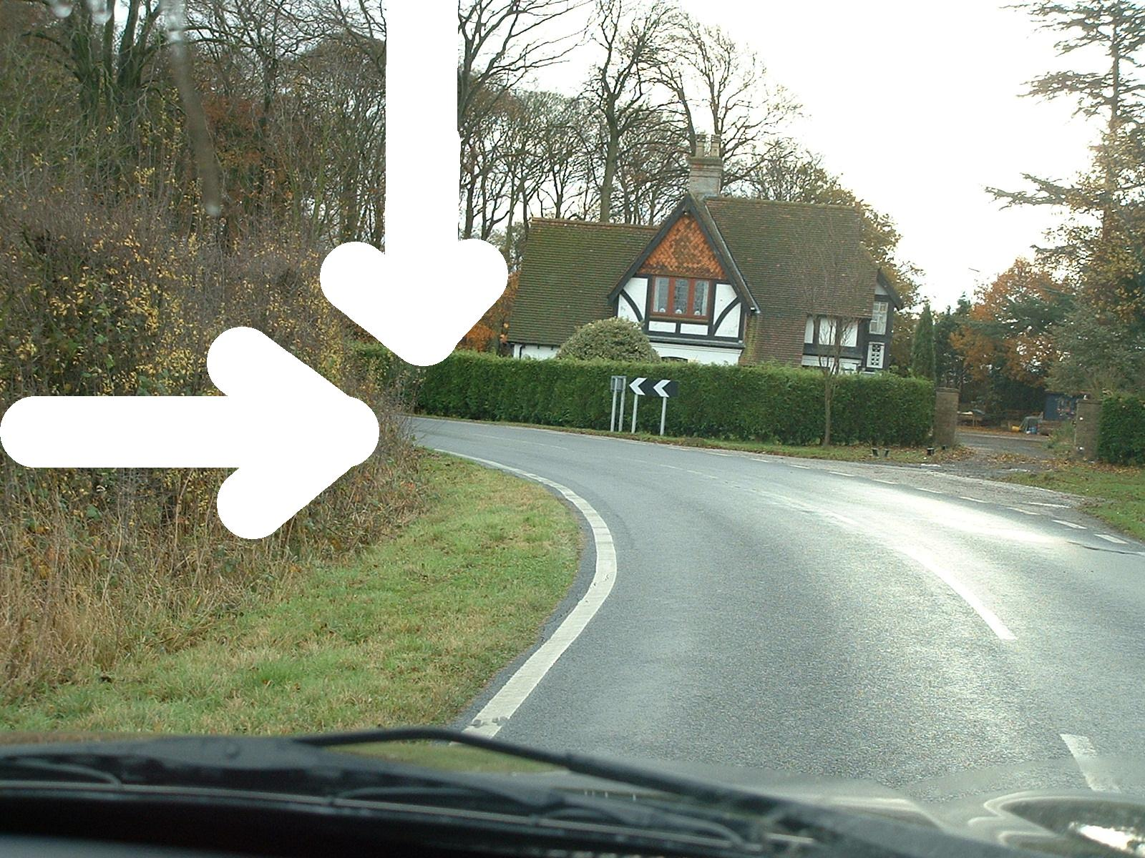
Notes:
The limit point is the furthest point along a road to which you have an uninterrupted view of the road surface. On a level stretch of road this will be where the right-hand side of the road appears to intersect with the left-hand side of the road. The limit point is used in a system of cornering called limit point analysis.

Slide 5
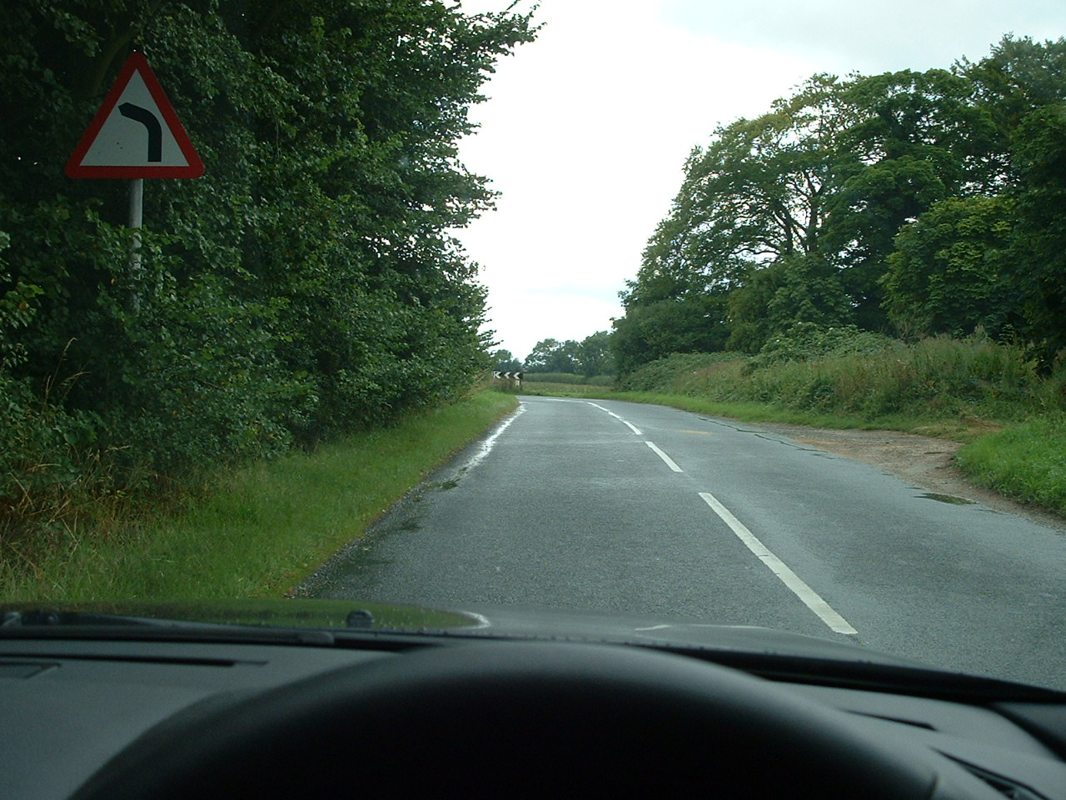

Slide 6
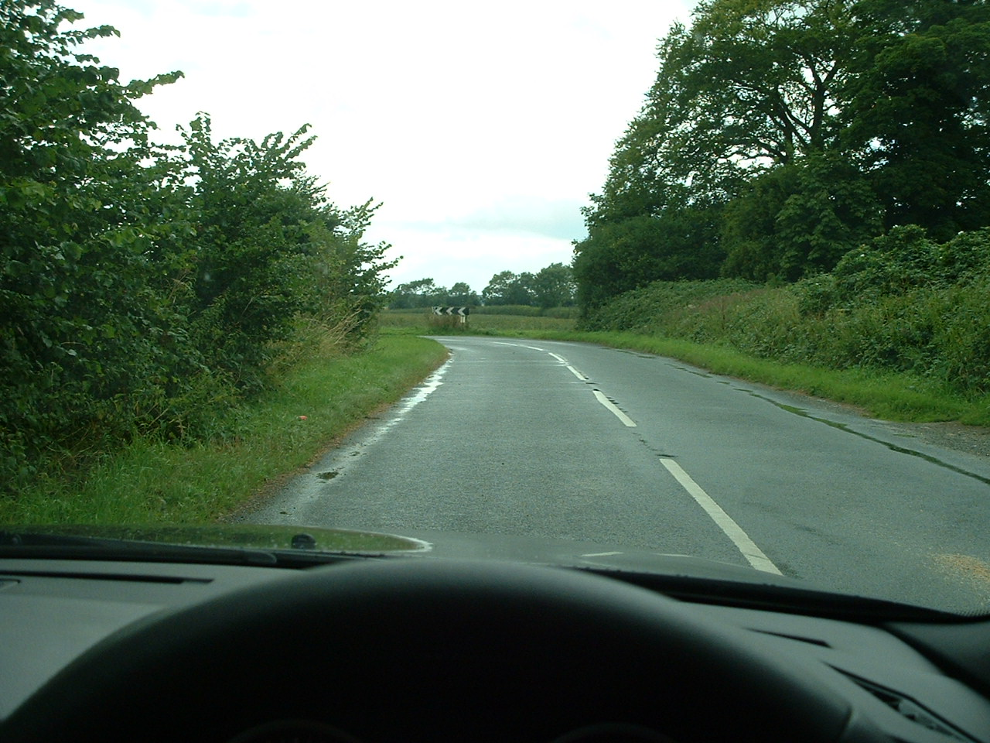

Slide 7
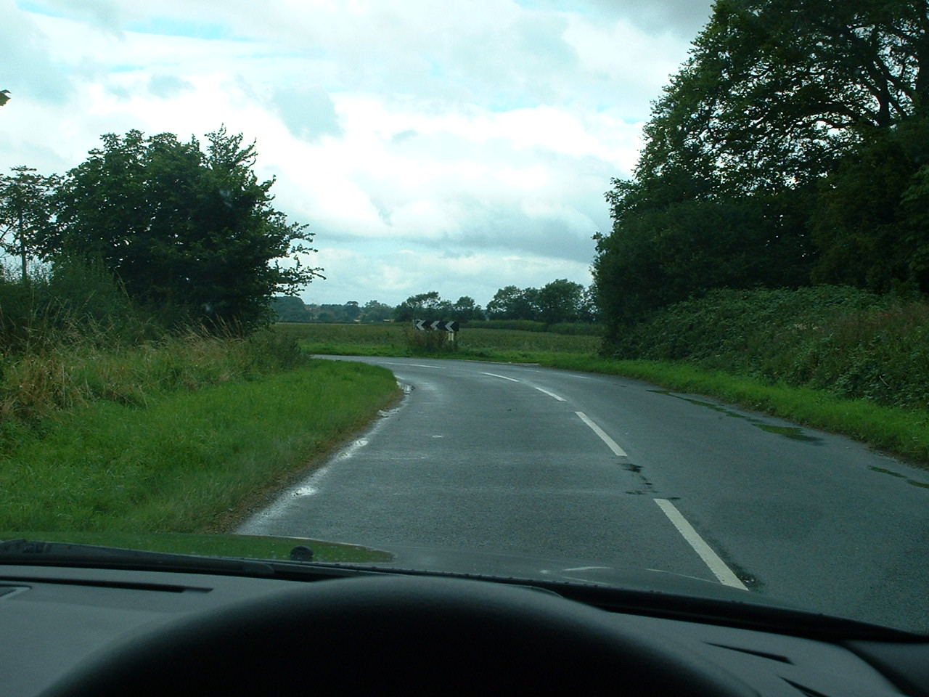

Slide 8
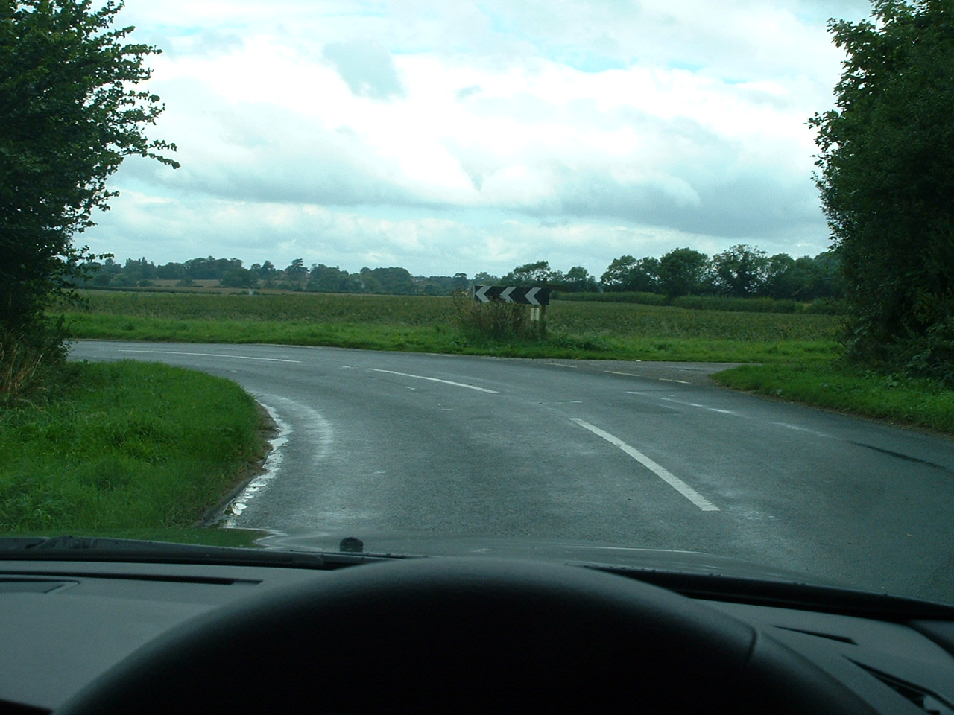

Slide 9
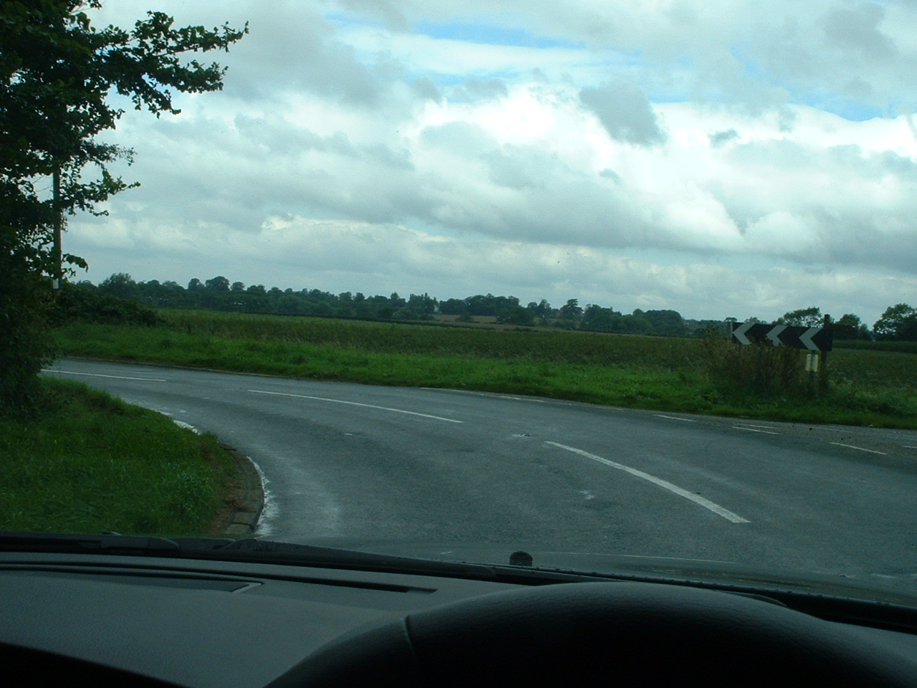

Slide 10
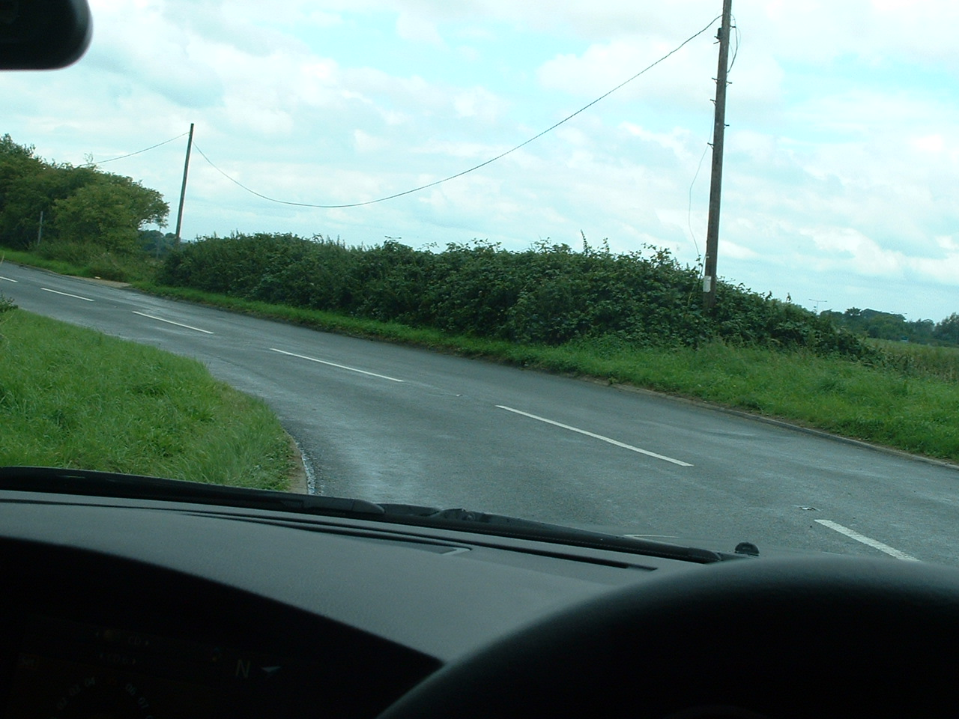

Slide 11
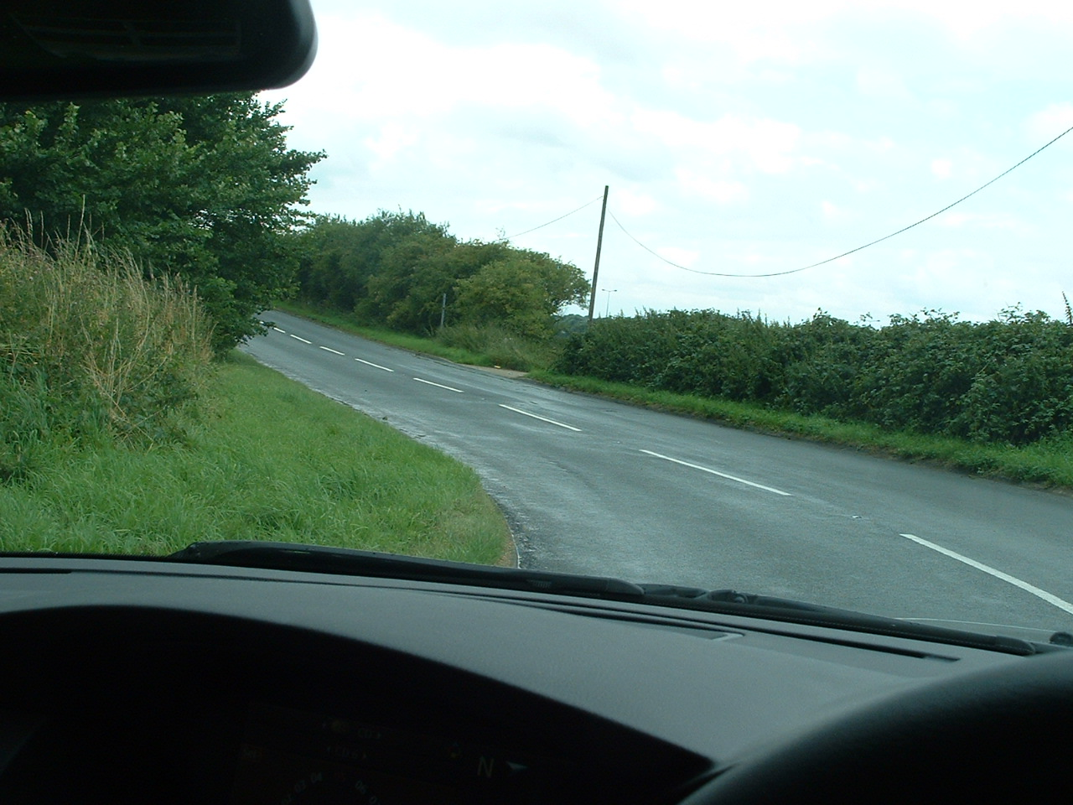

Slide 12
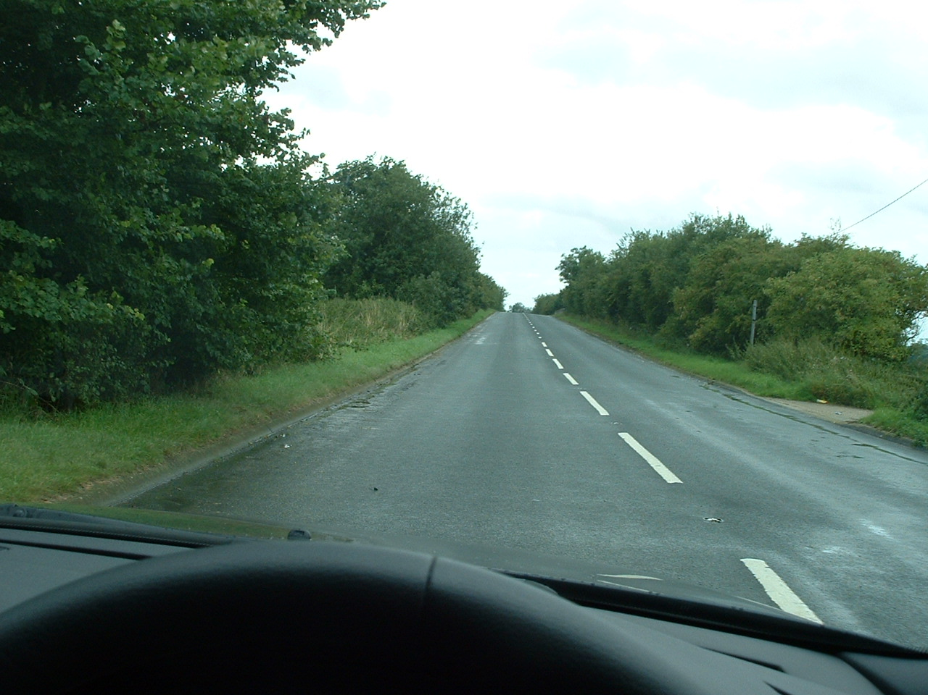

Slide 13
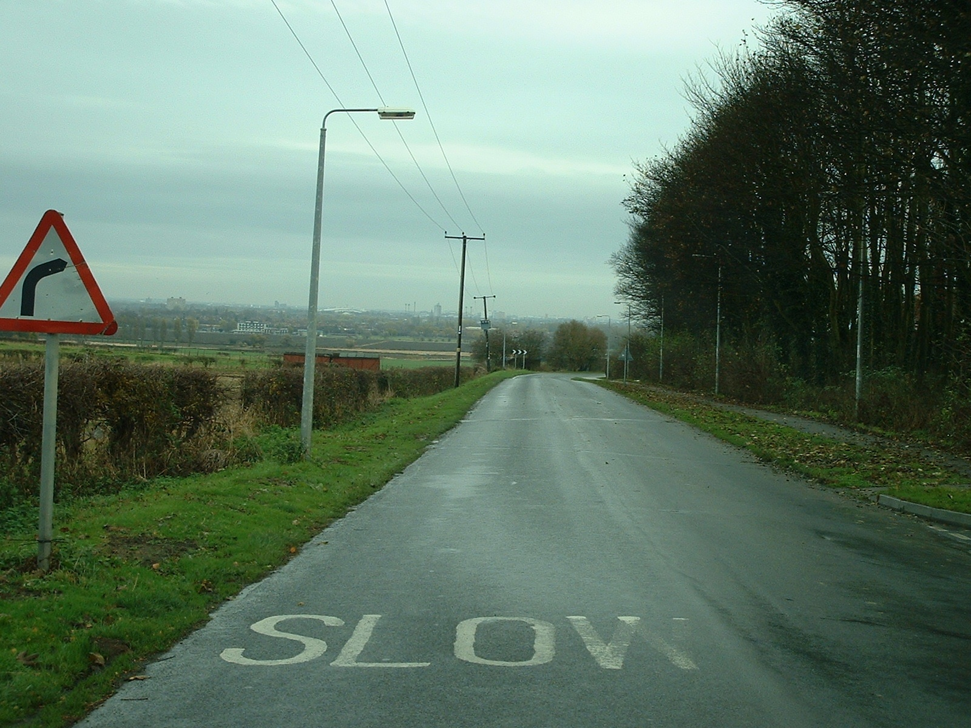
Notes:
Here is another example. We can clearly see the limit point on the right.

Slide 14
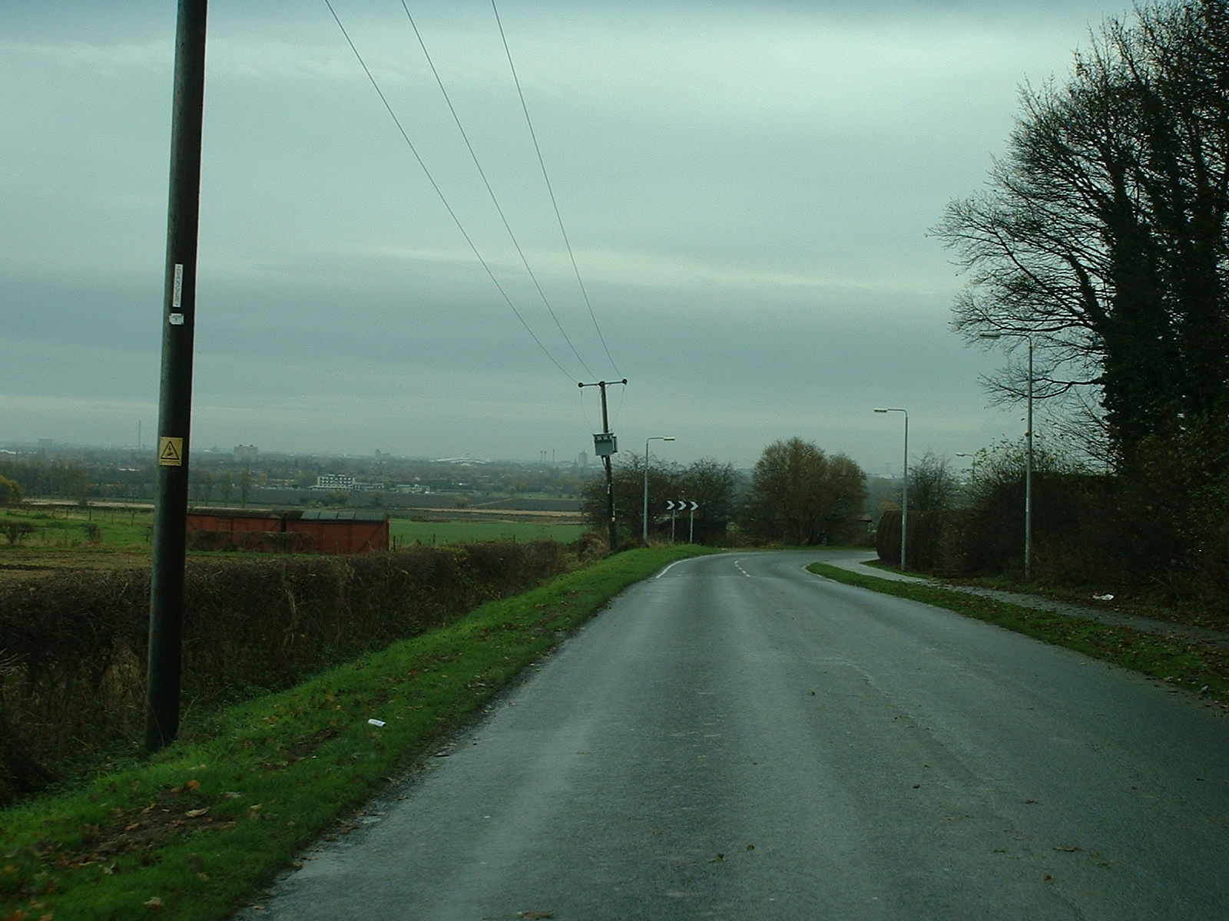
Notes:
Despite having moved forward considerably, the limit point has remained static. By that I mean the overall stopping distance has been reduced and we would therefore need to have reduced speed accordingly.

Slide 15
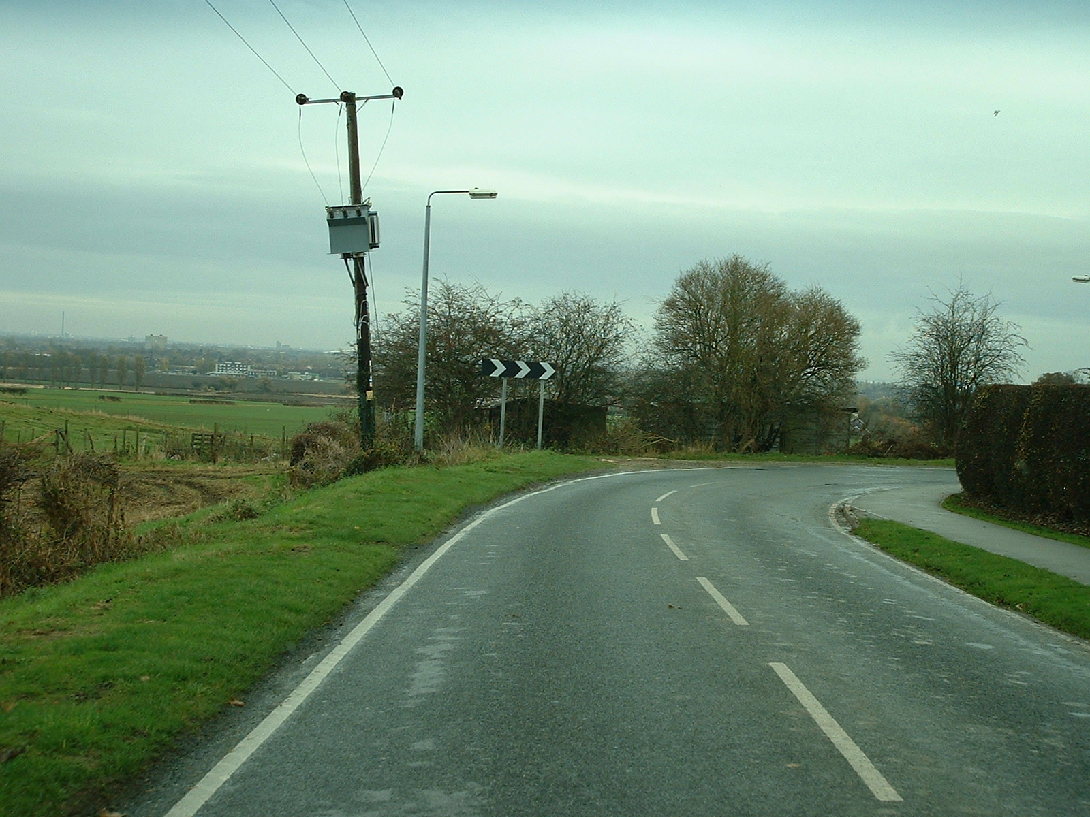
Notes:
We now see the limit point has hardly moved despite now being very close to the bend. Our speed may well have to be below 30mph at this point as the limit point is probably as close as 100 feet from the car.

Slide 16
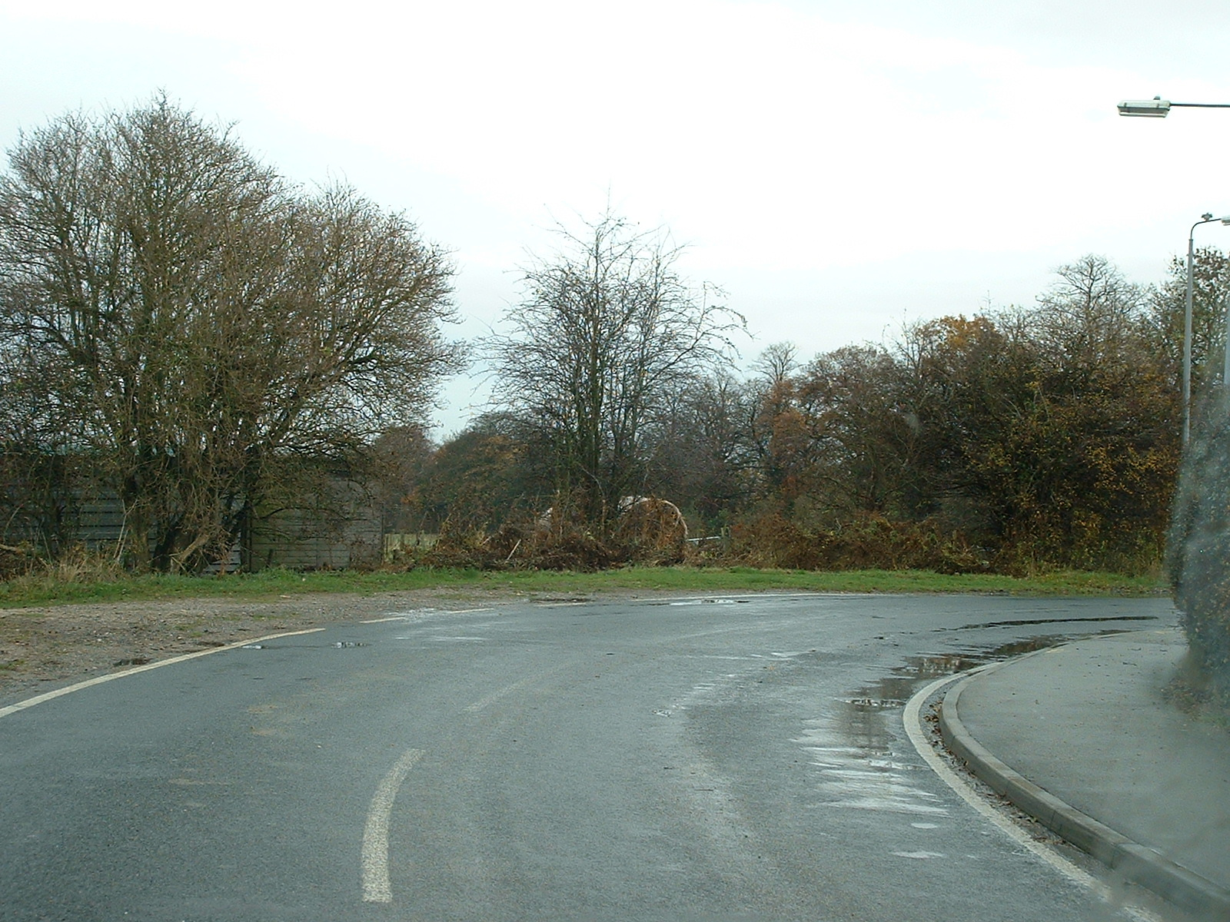
Notes:
As we enter the bend, we now see the limit point starting to move away from us and can now consider acceleration as our overall stopping distance is increasing.

Slide 17
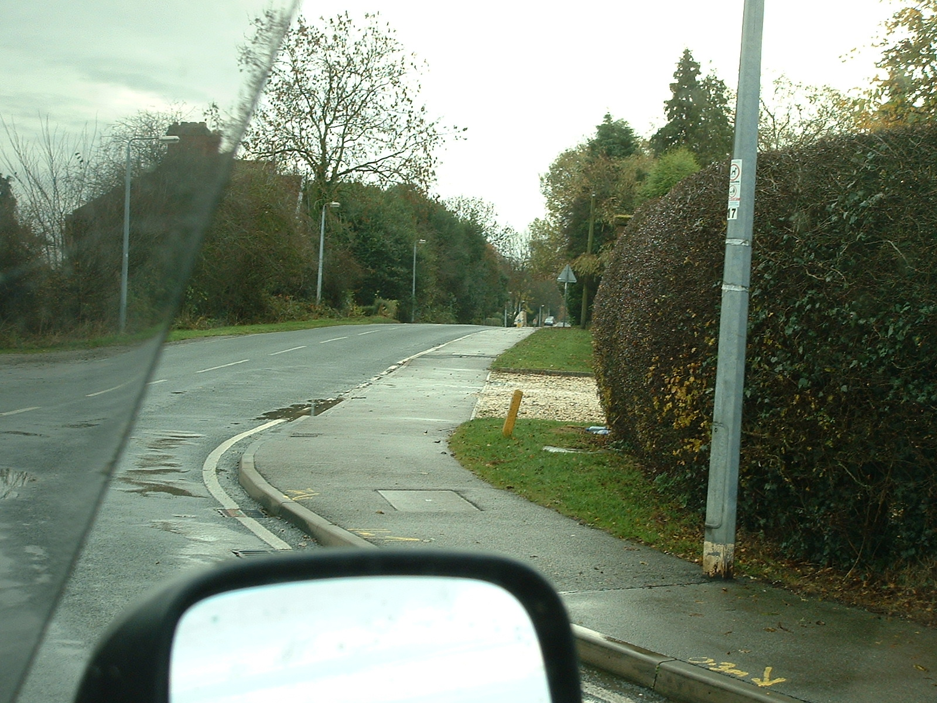
Notes:
The limit point has now moved away considerably allowing for a further increase in speed.

Slide 18
Points to Remember
Other vehicles can form part of the limit point.
At night, the limit point will never be further away than the range of your headlights.
In fog or spray conditions, the limit point will be restricted to the distance you can clearly see.
On single track roads, stopping distance must be doubled.
The limit point is self adjusting and allows the driver to apply the safe stopping rule.

Slide 19
You should always be able to stop your vehicle safely in the distance you can see to be clear on your own side of the road.

Slide 20
The Limit Point does not establish how fast you can drive! It does establish a speed that allows you to stop safely should the unexpected occur!

Slide 21
Any Questions?

