Slide 1
E - YARD
Tutor Training Programme
2018/2019

Slide 2
What is a Tutor?
A tutor is a person who provides assistance or tutelage to one or more people on certain subject areas or skills. The tutor spends a few hours on a daily, weekly, or monthly basis to transfer their expertise on the topic or skill to the student. Tutoring can take place in different settings, such as a classroom, a formal tutoring centre, or the home of the tutor/learner. As a teaching-learning method, tutoring is characterized by how it differs from formal teaching methods on the basis of the (in)formality of the setting as well as the flexibility in pedagogical methods in terms of duration, pace of teaching, evaluation and tutor-tutee rapport.

Slide 3
What makes a good Tutor?
Patience
Skill
Knowledge
Ability to teach
Able to put people at ease
Honesty
Maturity
Persistence
Commonsense
Morality
Flexibility
Passion
Communication

Slide 4
What makes a good Tutor? First Impressions Count!

Slide 5
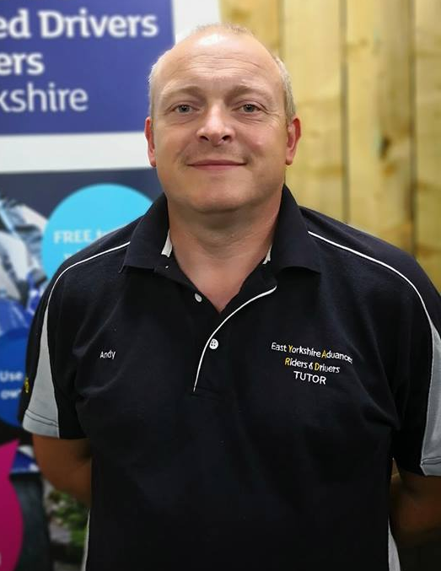
What makes a good Tutor? First Impressions Count!

Slide 6
First Contact!
Introduction –
Brief background to establish your credentials
Ascertain Associate background and their
aspirations – perceived strengths/development
Legal Aspects –
Documents and Eyesight checks

Slide 7
First Contact!
RIDE/DRIVE REQUIREMENTS –
Ride/Drive for yourself – Not to impress
Do nothing uncomfortable with – Don’t push
them to learn beyond their capability. Develop them
Ignore Tutor position – Explain your position re view,
control use etc.
Conduct of ride/drive – Observe all traffic signals and speed
limits particularly when considering overtakes
Separation strategy - Have an end location, ensure you have
swapped numbers, stop safely if separated etc. (bikes)

Slide 8
First Contact!

Slide 9
First Contact!
Safety First – Tutor Safeguarding
Your personal safety is paramount.
As a tutor you are potentially meeting strangers who could be anyone.
E-YARD registration protocol records details of associate members and with the financial transaction there is a confirmation of identity.
We do however offer taster ride and drive assessments to encourage new membership.
Please consider a brief entry on Facebook , Messenger or private message/text to a nominated person with details of time of session, meet and end point – a photo when you meet up (which can be used for the blog later – don’t make it an obvious issue) is a consideration
Initial assessments should take place on main roads and debrief should be at public places such as cafes – not roadside lay-bys for example

Slide 10
Training Logs
Notes:
Log owners details. Important to record who is the Assessor/Tutor. Check documents still in force tri-monthly

Slide 11
Training Logs
Notes:
Basic reminders of IPSGA / POWDERS / Brake test

Slide 12
Training Logs
Notes:
Full name. Group number is Year of joining and sequential 3 figure number issued membership sec. Type = car / bike. Check drivers licence and other documents. Check eyesight – 20m. Candidate to sign both boxes. Countersign doc checks.

Slide 13
Training Logs
Notes:
Not a Happy Sheet. Be honest. Candidate needs to know where strengths / weaknesses are. 1 & 2 will be initial assessment. Gaining weighted to 3 = bronze, 4 = silver, 5 = gold Do not say as such as may give false expectation. Free writing in comments area. No need to match line for line. Both to sign at time of de-brief. 28 areas match those of the examiners manual

Slide 14
Praise – Critique - Praise
Associates are all Volunteers!
Every Ride or Drive will have Positives and Negatives
Observe a Positive – i.e.‘Safe Drive’
Deal with ONE issue
End on a General Positive

Slide 15
Bite Size Chunks
Identify One Main Issue
Ask Associate to Review their own performance
Praise – Critique – Praise
Having Identified Issue to Associate deal with it for no longer than 5 – 10 minutes
Remember to finish on the Positive!
Notes:
ID major issue and concentrate on that. No more than 10 minutes discussion

Slide 16
K.I.S.S.
Keep
It
Simple
Stupid
Don’t overcomplicate things
(use IPSGA as the framework)
Notes:
Don’t overcomplicate

Slide 17
Identifying Faults
I.P.S.G.A.
Advanced driving/riding is an ability to control the position and speed of the vehicle safely, systematically and smoothly, using road and traffic conditions to progress unobtrusively with skill and responsibility. This skill requires a positive but courteous attitude and a high standard of driving/riding competence based on concentration, effective all round observation, anticipation, and planning. This must be coordinated with good handling skills. The vehicle should be at the right place on the road at the right time, travelling at the right speed with the correct gear engaged and can always be stopped safely on its own side of the road in the distance that can be seen to be clear

Slide 18
Identifying Faults
Identify anything dangerous!!!
A lot of faults will be minor in nature, sometimes hard to identify
Mr/Mrs Awkward – knows more than you
Drives middle of road – doesn’t consider overtakes
Poor signalling
Poor Positioning
Too close
Wrong Gear selection
Poor observations
Inconsistent
This list is not exhaustive – base feedback on IPSGA

Slide 19
Lesson Planning
Identify Fault - Previous Report/Record
Positioning? – Perhaps consider quiet unclassified roads with plenty of bends
Speed & Progress? – Look at RoadCraft and chapters such as overtaking
Gear Selection? – Again, maybe quiet roads where 2nd or 3rd gear are maximum required or ride/drive without using brakes (consider safety issues obviously!)
Notes:
Identify from previous records or choose most important / dangerous. No more than 2 hours. Max 45 minutes before stop. Consider stop place – make appropriate / safe – cafe, hard standing, lay-by – no gravel / potholes.

Slide 20
Lesson Planning
Lesson Length
No more than TWO HOURS is advised
Maximum 45 minutes between stops for debrief
Associates will be concentrating very hard and will become tired. 45 minutes will be the longest an associate will be able to safely concentrate.
Look for signs – poor position, comfort braking, loss of progress, fidgeting, leg stretching (motorcycles)
Notes:
Identify from previous records or choose most important / dangerous. No more than 2 hours. Max 45 minutes before stop. Consider stop place – make appropriate / safe – cafe, hard standing, lay-by – no gravel / potholes.

Slide 21
Lesson Planning
Have Rules!
Motorcyclists
Exchange Phone Numbers
Comms fitted? Use for BASIC input i.e. Directions or ‘one word’ instruction
Agree route – Comfort break. Final Destination.
Consider appropriate stops – hard standing? Cafe? Avoid gravel/potholes/ busy lay-bys
If separated agree system – Stop when safe. Don’t block entrances/bus stops etc.
Notes:
Identify from previous records or choose most important / dangerous. No more than 2 hours. Max 45 minutes before stop. Consider stop place – make appropriate / safe – cafe, hard standing, lay-by – no gravel / potholes.

Slide 22
Routes
What does the associate need?
What road type will benefit?
The test may include:
Multi Carriage
Major A Roads
Minor A Roads
B Roads
Unclassified
Notes:
Consider all manner of junction / roundabout / road type. Exchange mobiles numbers. Arrange system if seperated. Know set points along way and final destination.

Slide 23
Follow My Instructions
Take a sheet of plain paper and I will commence
I will give you instructions verbally
I will repeat those instructions once to ensure you have heard them
Follow them precisely as I say them

Slide 24
Follow My Instructions
What have you made?
Why have you made it?
What does it do?
Does it work?

Slide 25
Rote
Mechanical or habitual repetition of something to be learned.
(Oxford English Dictionary)
Learning something in order to be able to repeat it from memory, rather than in order to understand it
(Cambridge Dictionary)

Slide 26
Rote
What is the ‘Danger’ of learning by rote?
How can it be avoided?
What is the alternative?
What is the advantage of not doing so
What should the associate have instead?
TOOL BOX!!

Slide 27
Feedback
How?
What?
Why?
When?
OPEN QUESTIONS

Slide 28
Grading
Bronze
This grade should be awarded to riders and drivers whose driving/riding performance is significantly above the standard required to pass the basic driving/riding test. They will show a basic knowledge of Roadcraft, but lack the ability to consistently apply the System throughout the test. The ride or drive should be entirely safe, observing traffic signs, responding to hazards and capable of displaying techniques advocated for advanced drivers/riders.

Slide 29
Grading
Silver
This grade should be awarded to drivers/riders who are well above the average. They will produce consistently safe, acceptable and systematic drives/rides but without the final polish, flair and smoothness of the Gold driver/rider. They will demonstrate a thorough knowledge of the system of advanced driving/riding. Candidates must be able to drive/ride up to the permitted speed limits where it is safe to do so, but vary speed according to circumstances and conditions. It must be emphasized Silver is an extremely high grade and a commendable achievement.

Slide 30
Grading
Gold
This grade is recognized as the highest driving/riding standard available to the public. It should be awarded only to the polished systematic driver/rider, who displays a complete understanding and appropriate application of the principles outlined in Roadcraft. The candidate will display a confidence and ability throughout the whole test that leads the examiner to consider that, if afforded the opportunity, the candidate has the potential, with the basics already in place, to do well on a police advanced course. The candidate’s performance must be consistent throughout the whole of the test, so that significant lapses must result in a lower grade. Awards of this grade must therefore be reserved for the very best drivers/riders.

Slide 31
Grading
In summary.
Bronze – Has knowledge of RoadCraft but doesn’t apply consistently
Silver - Consistently applies RoadCraft but lacks smoothness. Too regimented.
Gold – Smooth and flowing consistent application of RoadCraft

Slide 32
Peer Review
As Tutors there will be an annual Quality Assessment (QA)
The formal QA will be carried out by an Advanced Tutor
Tutors are, however, encouraged to feedback to one another where opportunities present
Be honest and encourage one another to be the best you can

Slide 33
Peer Review
Training Documents
Tutor Assessment Report forms

Slide 34
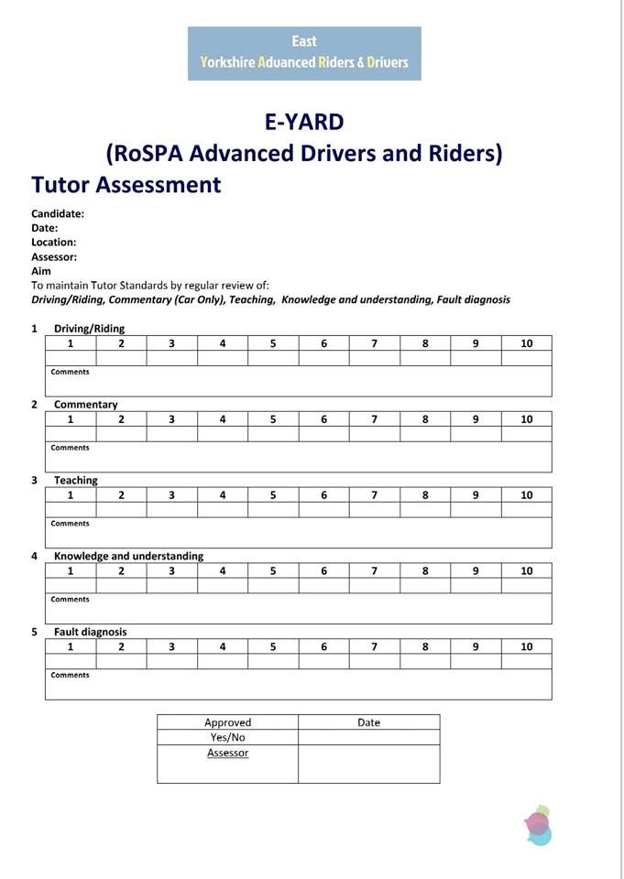
Peer Review

Slide 35
Peer Review
Tutor Assessment are marked 1-10
Unlike Training Logs which are graded 1-5
This allows for more accurate reflection
Box for comments
Complete and sign
(Not Yes/No)

Slide 36
Peer Review
Use ‘Report’ form to expand and evidence points
Drive/Ride – As you would an associate
Commentary – Car Only
Teaching – Techniques, Advice etc.
Knowledge – Use of RoadCraft/Highway Code
Fault Diagnosis – Identify, Praise – Critique - Praise

Slide 37
Group Riding
E-YARD prides itself on the social aspect of the
Bike Section.
Ride outs – Breakfast Club – are Group organised
Events.
As such these rides need to reflect both E-YARD
and RoSPA high standards
Whilst not always possible, Group/Breakfast Club
runs should ideally be led by a Group Tutor and all
present should be briefed regarding basic safety rules and
standards

Slide 38
Group Riding

Slide 39
Group Riding
At start of the ride a lead rider is nominated - Lead Rider (Lead)
A tail end rider is nominated - Tail End Charlie (TEC)
Both should be easily identifiable and identified to rest of group
Neither of these riders will change their position through the ride
When travelling straight ahead follow the road
When a junction is reached the second rider (rider behind Lead) will stop and indicate to other riders which direction to take
(Generally this will be whenever the turn is off the 'road ahead')
The 'second rider' will remain in place until TEC arrives, at which point they can set off becoming second to last rider (TEC remains last rider) until the next junction/turn is encountered
By adopting this system it allows riders of all abilities to ride safely in the group
There is no pressure to play catch up or keep rider ahead or behind in view
There is no need to 'jump' red lights or exceed the speed limit
Overtaking is allowed, but must be done safely, lawfully and with due consideration to other group members and road users - it is not a race

Slide 40
Group Riding
At start of the ride a lead rider is nominated - Lead Rider (Lead)
On open roads ride in 'staggered' formation, offset from the rider in front - this allows safer stopping distances and takes up less road space keeping the group together
When travelling in built up areas such as towns close up and ride a little closer
At traffic lights pull up two abreast - this takes up less space and assists in getting through the lights more efficiently as a group

Slide 41
On open roads ride in 'staggered' formation, offset from the rider in front - this allows safer stopping distances and takes up less road space keeping the group together

Slide 42
When travelling in built up areas such as towns close up and ride a little closer
At traffic lights pull up two abreast - this takes up less space and assists in getting through the lights more efficiently as a group

Slide 43
When riding open roads the 'staggered' formation allows for other riders to slip into the ‘space’ between other bikes for, in the above example approaching a left bend. (Bikes will be further apart than the diagram allows)

Slide 44
Only a Fool Breaks The Two Second Rule
When riding line astern through a series of bends ensure riders know to have a ’Two Second’ minimum safety distance

Slide 45
Second Man Drop Off

Slide 46
Any Questions?

