Slide 1
Tyres!
A Presentation by
Chris Hood

Slide 2
So What Are Tyres?
Primary Contact with the Road Surface
Enable vehicle to create traction
Provide grip to stop
Form part of vehicle suspension
Help comfort levels for passengers

Slide 3
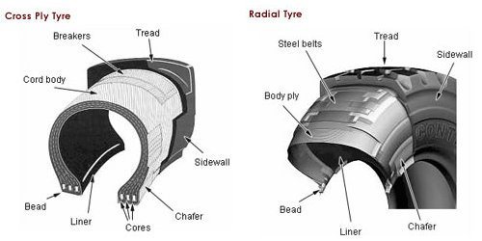
So What Are Tyres?

Slide 4
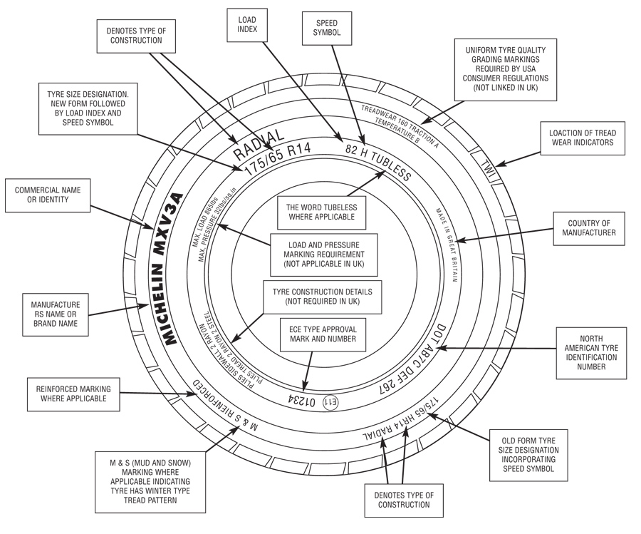
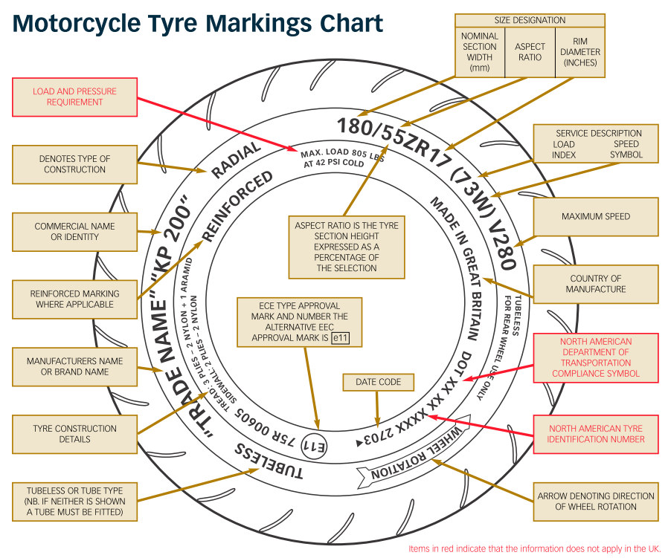
So What Are Tyres?

Slide 5
How do tyres work?
Fit correctly to wheel rim – Beads
Manufacturers recommended pressures
Valves – Clean and seated correctly
Dust Caps – the final seal

Slide 6
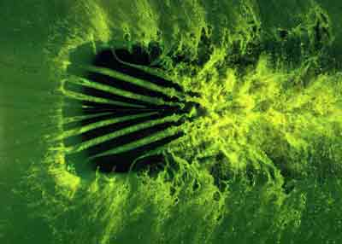
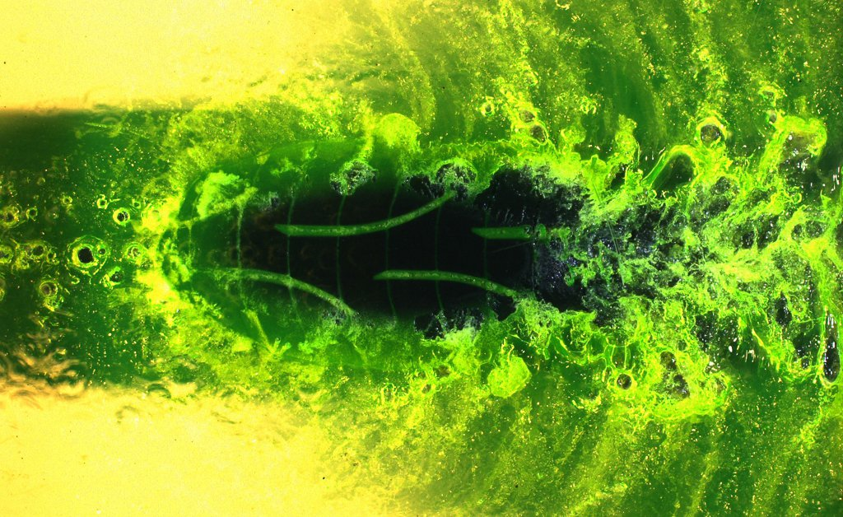
How do tyres work?

Slide 7
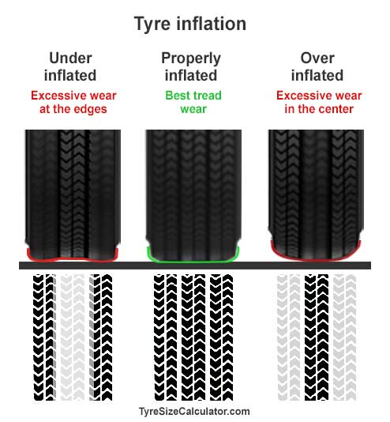

Slide 8
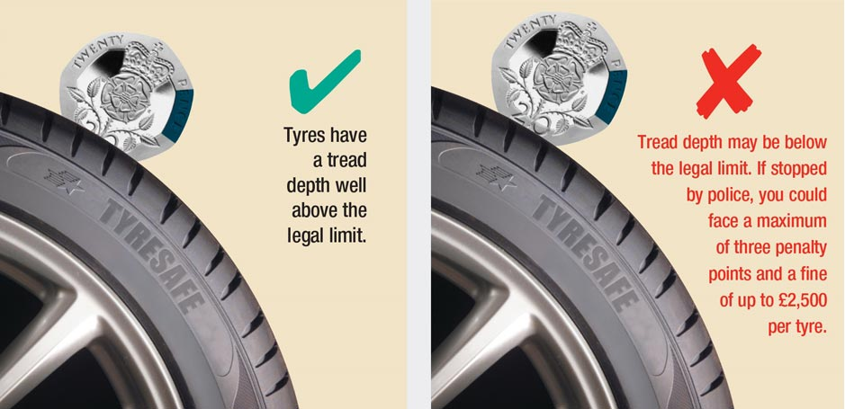
Tread Depth Check

Slide 9
Any Questions?

