Slide 1
Hazards!
A Presentation by
Chris Hood

Slide 2
What is a Hazard?
Anything!
That is...anything which is an actual or potential danger
Notes:
Passes must be worn and visible at all times.
Fire Alarms test on Fridays Mornings and is a very loud unmistakeable Din! Do not use the lift in the event of fire, use the external staircase which is almost directly outside of this room on the right. Walk around the building to fire point ????? Which is at the opposite side of the front car park.
No smoking on site or in vehicles. There is a smoke room situated on the ground floor and a member of the training team will be able to direct you.
Toilets, out the door, turn left, across the landing and on this floor, the gents are on the left and the ladies on the right.
Mobile Telephones must be turned off or silent in the building and in cars. No mobile when mobile!

Slide 3
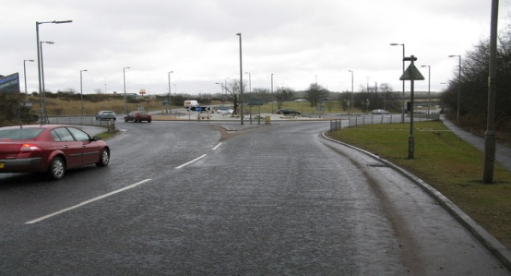
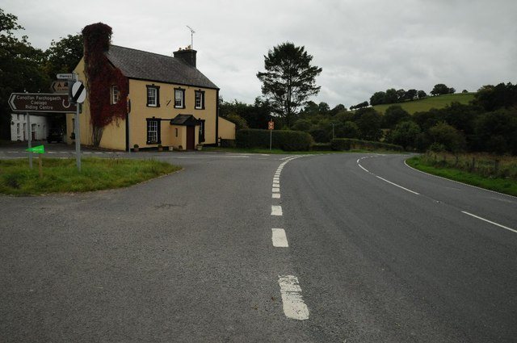
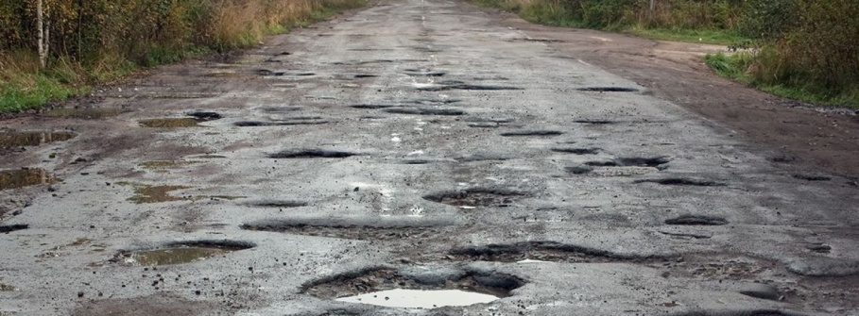
Types of Hazard
Physical
What is a Physical Hazard?
Junctions
Bends
Road Surface
Notes:
Let’s take a look at the definition of the words!

Slide 4
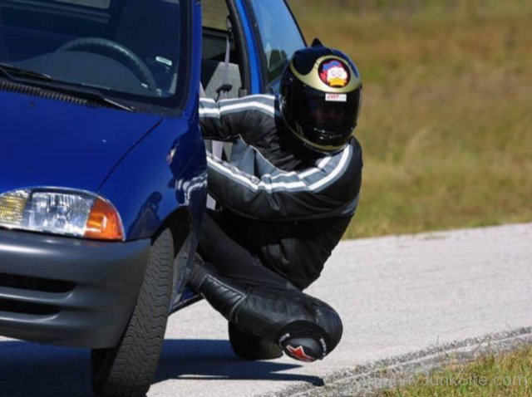
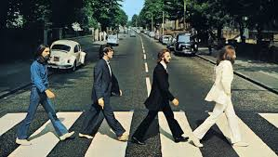
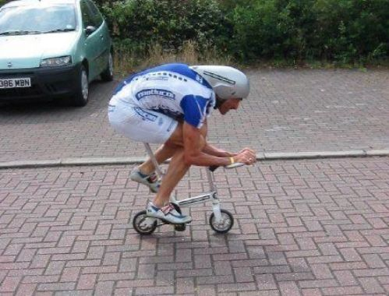
Types of Hazard
2. Other Road Users
Position/Movement
Drivers
Pedestrians
Cyclists
Notes:
Let’s take a look at the definition of the words!

Slide 5
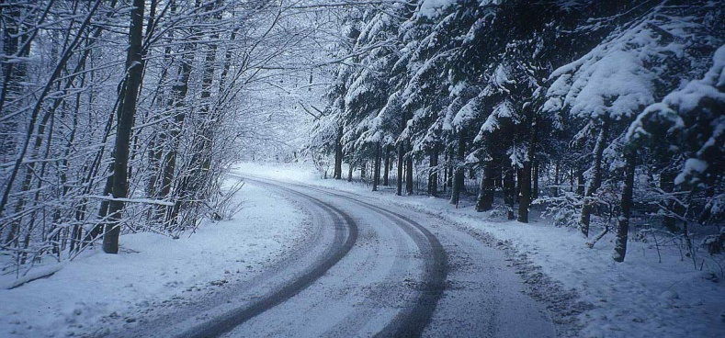
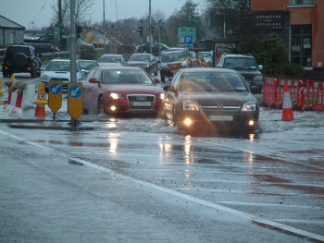
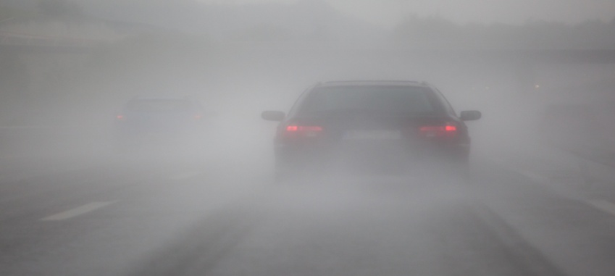
Types of Hazard
3. Weather
Ice
Rain
Visibility
Notes:
Let’s take a look at the definition of the words!

Slide 6
Types of Hazard
C.O.A.S.T.
Concentration - Application of the mind to the task in hand
Observation – Don’t look – SEE
Anticipation – Signs, Smells, knowledge
Space – Only a fool breaks the two second rule
Time – To Plan or React
Notes:
Let’s take a look at the definition of the words!

Slide 7
Dealing with the Hazard
What Can Be Seen
What Can’t Be Seen
What Can Reasonably Be Expected
Notes:
Let’s take a look at the definition of the words!

Slide 8
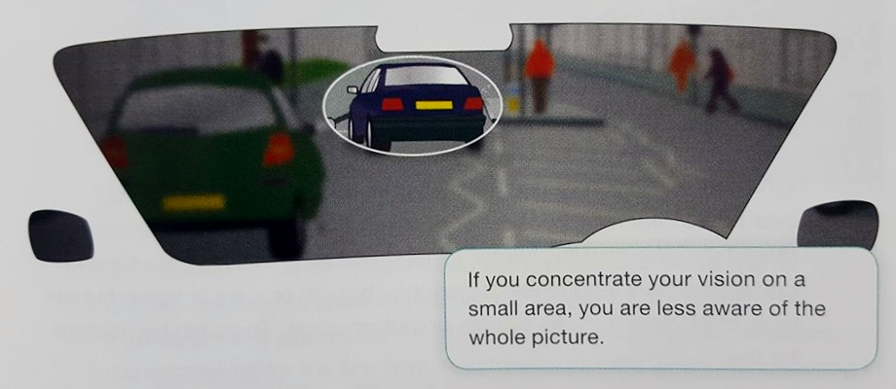
Dealing with the Hazard
Scanning & Planning
Notes:
Let’s take a look at the definition of the words!

Slide 9
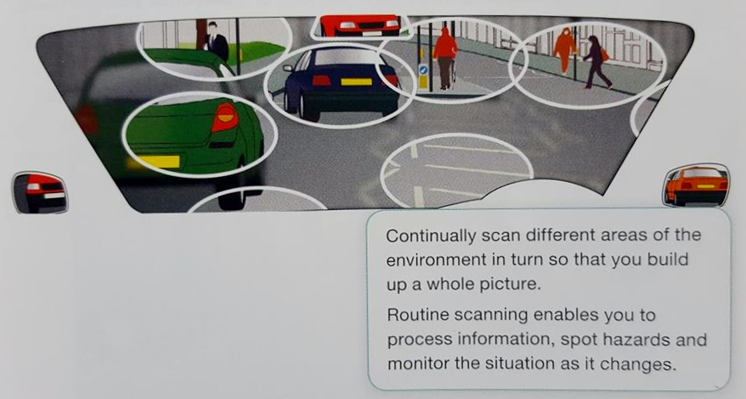
Dealing with the Hazard
Scanning & Planning
Notes:
Let’s take a look at the definition of the words!

Slide 10
Planning
Always be able to stop on your own side of the road in the distance you can see to be clear
Notes:
Let’s take a look at the definition of the words!

Slide 11
Any Questions?

