Slide 1

I AM SAFE or am I???
Pre-ride checks or a whole-journey mentality?

Slide 2
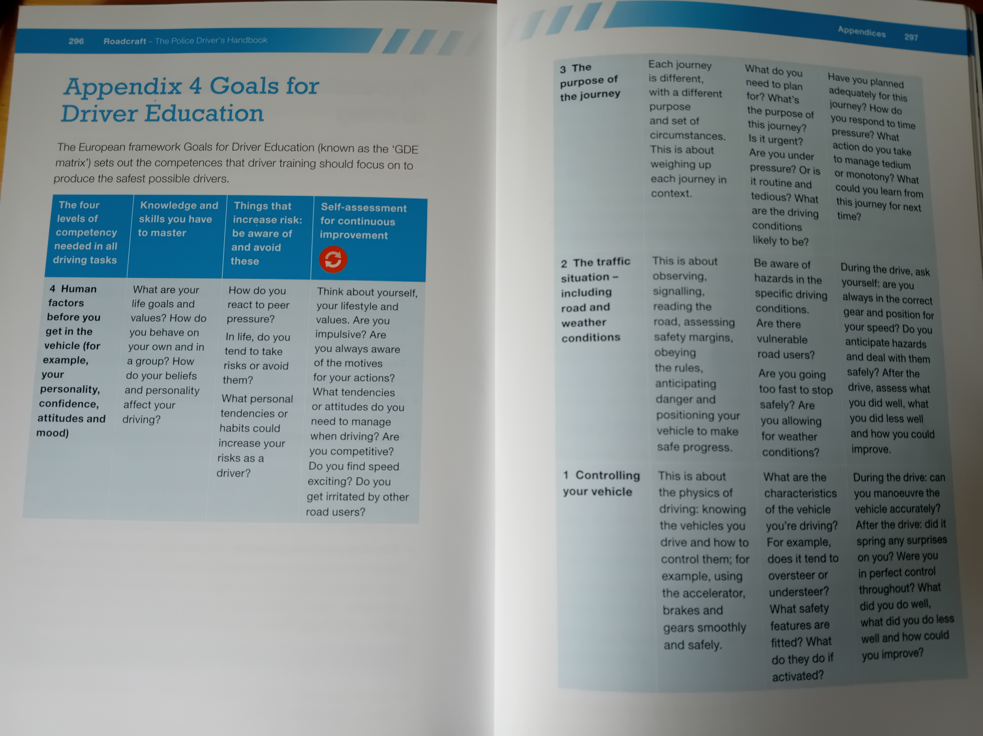
EGDE
Human Factors
Purpose of the Journey
Traffic situation (inc. Weather) – Physical Conditions
Controlling your Vehicle

Slide 3
Pre-drive/ride checks?
Why do them?

Slide 4
CHECKS?
- POWDDERSS
- IAMSAFE
- SBT
- MBT
- Cockpit/Cluster Check

Slide 5
Petrol / Propellant
Oil – including brakes
Water – coolant / screenwash etc.
Damage – why relevant?
Drive – why not in the car version???
Electronics – including horn
Rubbers – tyres; wipers; grips (inc. for feet)
Steering – why not in the car version???
Suspension – why not in the car version???

Slide 6
Illness
Attitude
Medication
Sleep
Alcohol
Food
Emotion

Slide 7
These are NOT ONLY pre-drive/ride checks
“Even before you get in a vehicle, you should always assess whether you’re fit to drive”
- Human Factors
- Purpose of the Journey
- Traffic situation (inc. Weather) -- Controlling your Vehicle

Slide 8
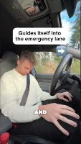
Illness
Epilepsy
Recent Stroke/TIAs
Narcolepsy
Sight loss
Mental health conditions
MANY MORE!

Slide 9
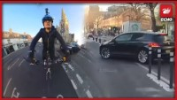
Attitude
- Avoid judgement on what happens… Think about the attitudes of both the cyclist and the car driver. Who has a safe attitude? Who has an unsafe attitude? WHY?

Slide 10
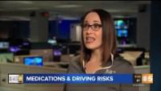
Medication
“Well, the doctor didn’t say I couldn’t drive…”

Slide 11
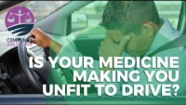
Medication
“Well, the doctor didn’t say I couldn’t drive…”

Slide 12
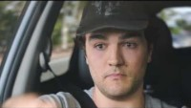
Sleep

Slide 13
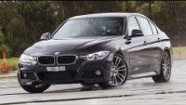
Alcohol - More than 200 people die per year
UK:
80mg/100ml blood
OR
35micrograms / 100ml breath
HIGHER limit than the video

Slide 14
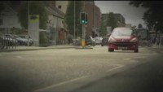
Food – and fluids
Why might dehydration be even more of an issue for bikers?

Slide 15
EMOTION – The BIG one!!
Name some emotions…

Slide 16
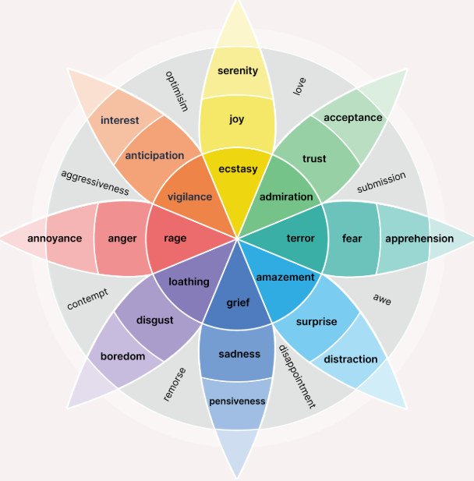
EMOTION – The BIG one!!

Slide 17
EMOTION – The BIG one!!
Many people ENJOY being ANGRY
Many people ENJOY being RIGHT
Many people ENJOY being JUDGEMENTAL
Many people ENJOY being BETTER than someone else
Very few people ACCEPT mistakes
Very few people MOVE ON and THINK RATIONALLY
The ability to do so is a major trait of an advanced rider/driver.

Slide 18
EMOTION – The BIG one!!
We are born with 6 basic emotions – all designed to give a physical response:
Surprise: Opens our eyes wide to take in new information when something unexpected happens.
Fear: Warns us of immediate danger so we can run away or hide.
Disgust: Turns us away from rotten food, toxins, or disease.
Anger: Gives us the energy to fight back and defend our territory or loved ones.
Happiness: Rewards positive actions and helps build strong social bonds with others.
Sadness: Signals when we have lost someone or something, asking others for help and support.

Slide 19
EMOTION – The BIG one!!
RED MIST

Slide 20
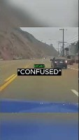
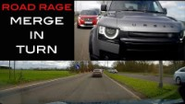
EMOTION – Please excuse any language

Slide 21
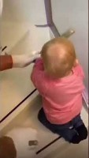
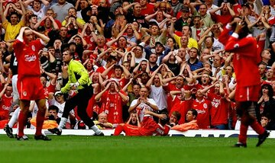
EMOTION – Can be controlled
Emotions are copied instinctively by people around you

Slide 22
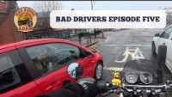
EMOTION – The BIG one!!

Slide 23
I AM SAFE
An ongoing mentality – NOT a pre-ride check

