Slide 1


E-YARD
East Yorkshire Advanced Riders and Drivers
Adult Learning Principles
Adam Abel, RoSPA Advanced Tutor
E-YARD Training Lead

Slide 2
ADAM ABEL - RoSPA ADVANCED TUTOR, GROUP TREASURER AND TRAINING LEAD.
I HAVE BEEN RIDING MOTORBIKES LEGALLY SINCE 1996. INITIALLY A LONG LINE OF SPORTS BIKES, BUT ALSO ADVENTURE BIKES AND ENDUROS SINCE 2008.
HAVING BECOME AN ADVANCED RIDER BY PASSING THE IAM ADVANCED BIKE TEST IN 1998, I SOON BECAME AN IAM OBSERVER. HOWEVER, DUE TO MOVING AROUND A LOT WHILST IN THE ARMY I DID MOST OF MY INSTRUCTING PRIVATELY FOR FRIENDS AND MUTUAL ACQUAINTANCES WHILST ADMIN FOR VISORDOWN.COM.
RIDING IN GENERAL, AND ADVANCED RIDING SPECIFICALLY, HAS LONG BEEN MY PASSION IN LIFE AND SINCE QUALIFYING AS A PARAMEDIC IN 2014 HAS TAKEN UP MOST, IF NOT QUITE ALL OF MY SPARE TIME.
AFTER LEAVING THE ARMY AND SETTLING IN NORTH YORKSHIRE I GAINED A RoSPA GOLD WITH ARNY IN 2016 AND BECAME A TUTOR WITH THEM IN 2017.
ON MOVING TO EAST YORKSHIRE, EYARD MADE MORE SENSE AS MY LOCAL GROUP, SO I BEGAN TUTORING FOR THE GROUP IN 2021 AND GAINED THE ADVANCED TUTOR QUALIFICATION IN 2022.

Slide 3
Pedagogy
Vs
Andragogy

Slide 4
Child Learning
Vs
Adult Learning

Slide 5
Pedagogy
Peda=Child gogy=leader
“Leading children”
Facilitator driven. The teacher tells the child what they/the syllabus think is important.

Slide 6


Slide 7
Andragogy
Andra=adult gogy=leader
“Leading adults”
Learner driven. The facilitator serves the learners needs. Goal and relevancy directed.

Slide 8


Slide 9
Knowles’ Adult Learning Theory - Andragogy
(Malcolm Knowles, American adult educator 1967)
A set of 6 assumptions that can be made about adult learners that apply to all adult learning situations.
They can be used as a guide for developing the adult learning environment.
Adult learning is distinct and differs from that of childhood learning.
Adults are generally self directed and expect to take responsibility for decisions.

Slide 10
1 The Need to Know
“adults need to know why they need to know something before undertaking to learn it”
Explaining the purpose and learning outcome of a session/subject increases the chance that the adult learner will be motivated to learn it.
They need to see a point in learning it.

Slide 11
How can we best serve the learner’s need to know?
Initial Evaluation - shows them practically what they have previously missed through lack of observation, anticipation and imagination, plus being in an imperfect position.
This shows the need to continue learning.
Continued (graphic?) explanation of what could go wrong will cement the need to learn each subject as it is broached.
They need to see it for themselves, not simply be told.

Slide 12
2 The Learner’s Self-Concept
“Adults have a self-concept of being responsible for their own decisions, for their own lives”
The learner needs to come to their own decision through collaborative understanding and learning as an equal. Incorporate the learners life experiences as a valuable resource.
Adult learners need to be viewed as capable, so activities should provide opportunity for learners to show their capabilities and knowledge.
Learners should be encouraged to anticipate in group projects and collaborative activities.
Simply telling the learner how it is done is not adequate.

Slide 13
How can we best serve the learner’s Self-Concept?
Request they read around the subjects within Roadcraft and Highway Code and then show us their knowledge and capabilities.
Discuss their thoughts and ideas on a subject as an equal.
Encourage the learner to suggest solutions rather than tell them how to do it.

Slide 14
3 The Learner’s Prior (and continued) Experiences
Adults have different life experiences to children; they have been around longer in different environments.
Encouraging connection of learning to previous life experiences can help better understanding.
Share experiences as an equal and allow the learner to suggest activities and steer conversations, which allows for interaction that may lead to better understanding.
Participating and contributing to their own learning will lead to better engagement and motivation to learn.
Allow for discussions that are encouraging and conducive to learners sharing their personal experiences, ideas and opinions.

Slide 15
How can we best serve the learner’s prior experiences?
By first acknowledging that they have a wealth of prior knowledge and experience.
Don’t front load the “correct” answer.
Seek at least a partial answer from the learner.
Ask open questions to gauge their relevant previous experiences.
Often the “correct” answer is staring them in the face; they just need to complete the picture.

Slide 16
4 The Learner’s Readiness to Learn
The needs of the learner must be addressed quickly to ensure the success of learners.
Learning must have relevance.
Ideas Concerns and Expectations should be addressed promptly.

Slide 17
How can we best serve the learner’s readiness to learn?
Explore the learners generic ideas, concerns and expectations on day one.
As each new subject is broached, explore specific ideas, concerns and expectations.
The role of the tutor is to address the learners ideas, concerns and expectations, whilst facilitating their knowledge of the theory, then marrying it with the practical riding/driving of their vehicle.

Slide 18
5 The Learner’s Orientation to Learning
Problem centred rather than content centred.
Adult learners are motivated to learn when given authentic learning activities.
Authentic learning activities provide meaning beyond the learning environment.
Task based activities help learners get sense of how to apply principles.
It is critical to the success of learners that they are provided with activities that capture their attention and keep them engaged.

Slide 19
How can we best serve the learner’s orientation to learning?
Real world examples and scenarios.
Theory is great to explain a concept.
Authenticity is key to demonstrate.

Slide 20
6 The Learner’s Motivation
Adult learners are intrinsically motivated to learn.
External motivators are not as effective.
They wouldn’t have chosen to learn if they didn’t want to.
Providing an environment that engages the learner and encourages them to be active participants supports that intrinsic motivation.
Simply lecturing with a display of your knowledge to a passive audience does not work.
Learners must feel they are appreciated, valued and respected.

Slide 21
How can we best serve the learner’s motivation?
Don’t spoon feed the answer.
Ask open questions to get the answer from them.
Encourage when they aren’t quite there.
Show appreciation when they are.

Slide 22
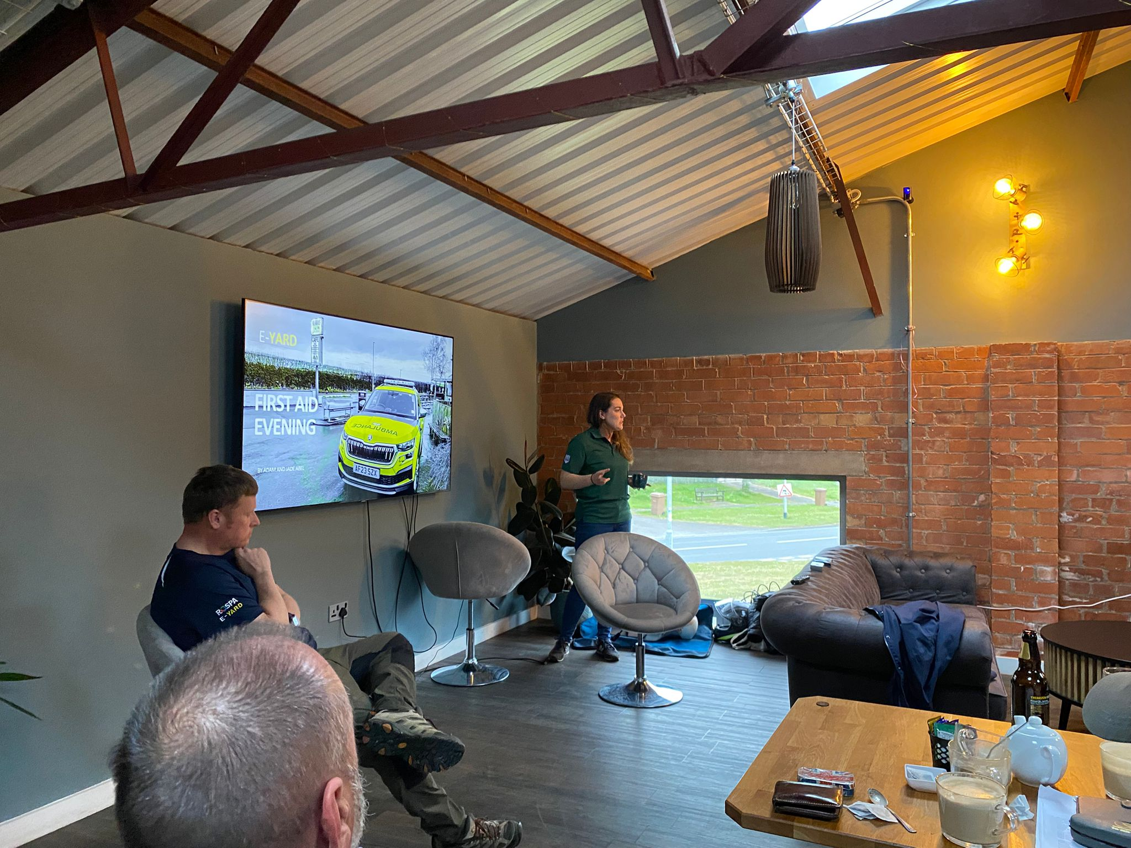

Slide 23
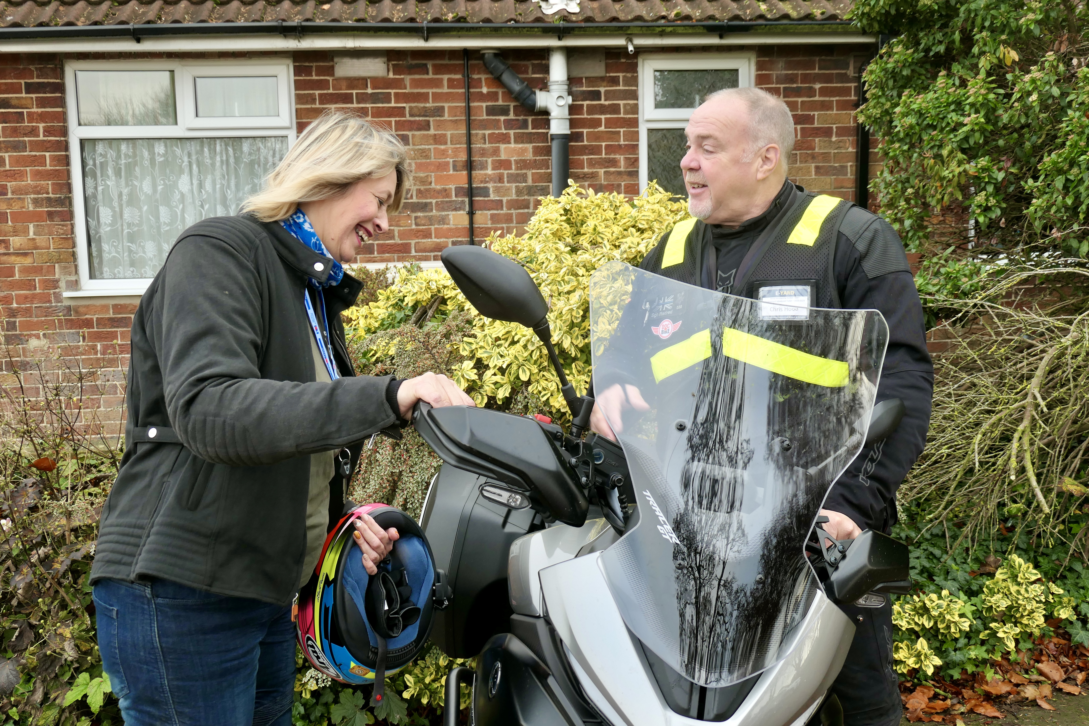

Slide 24
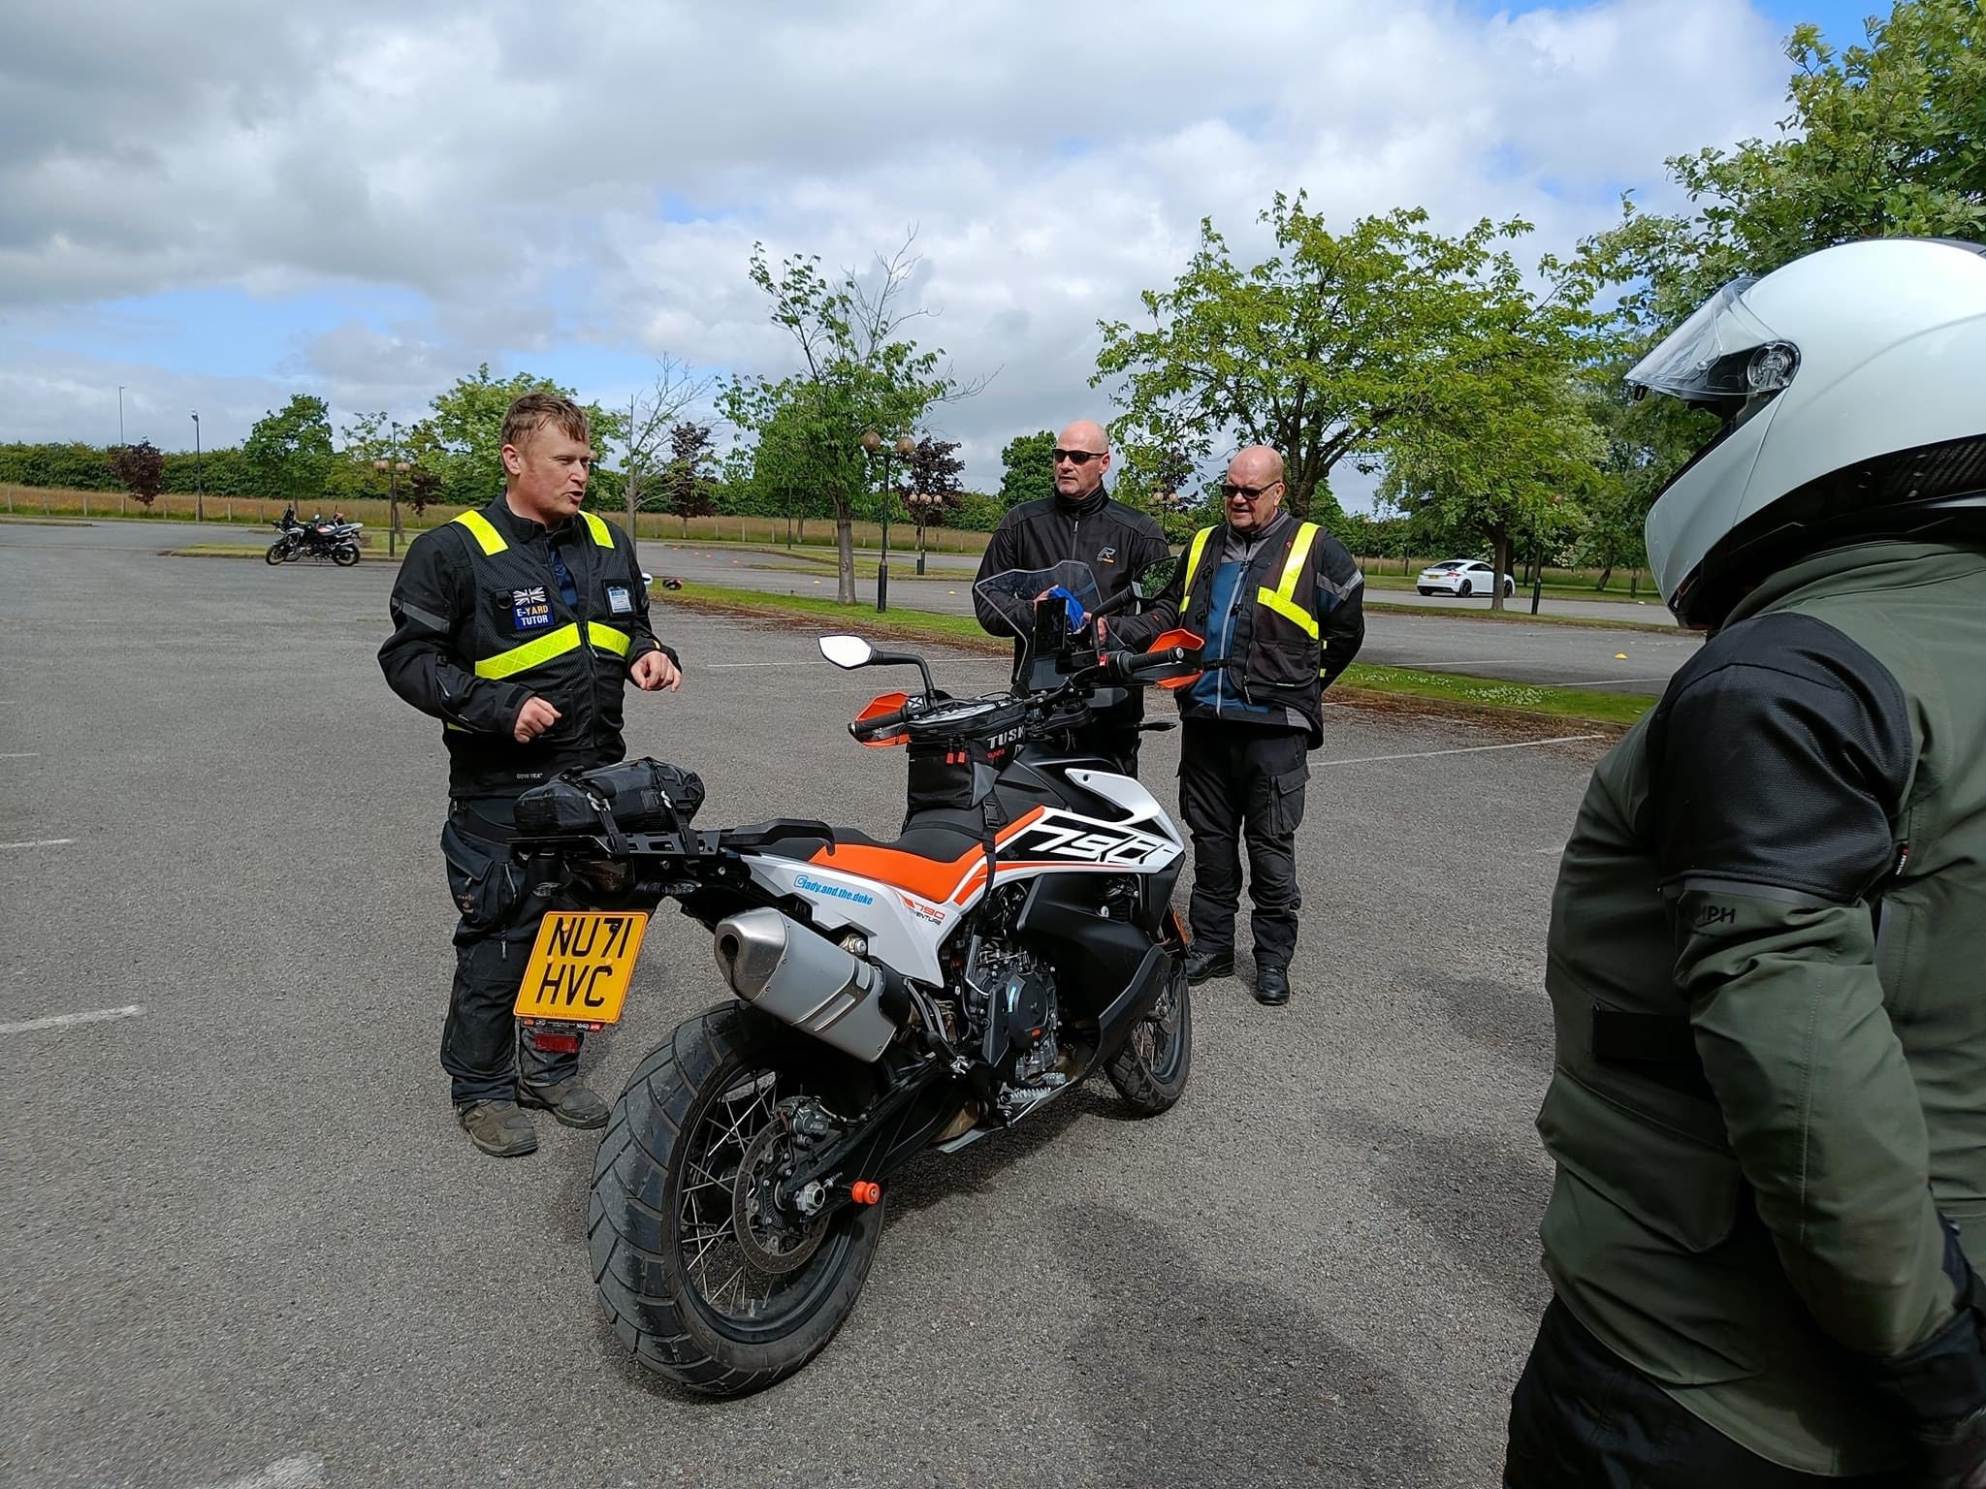

Slide 25
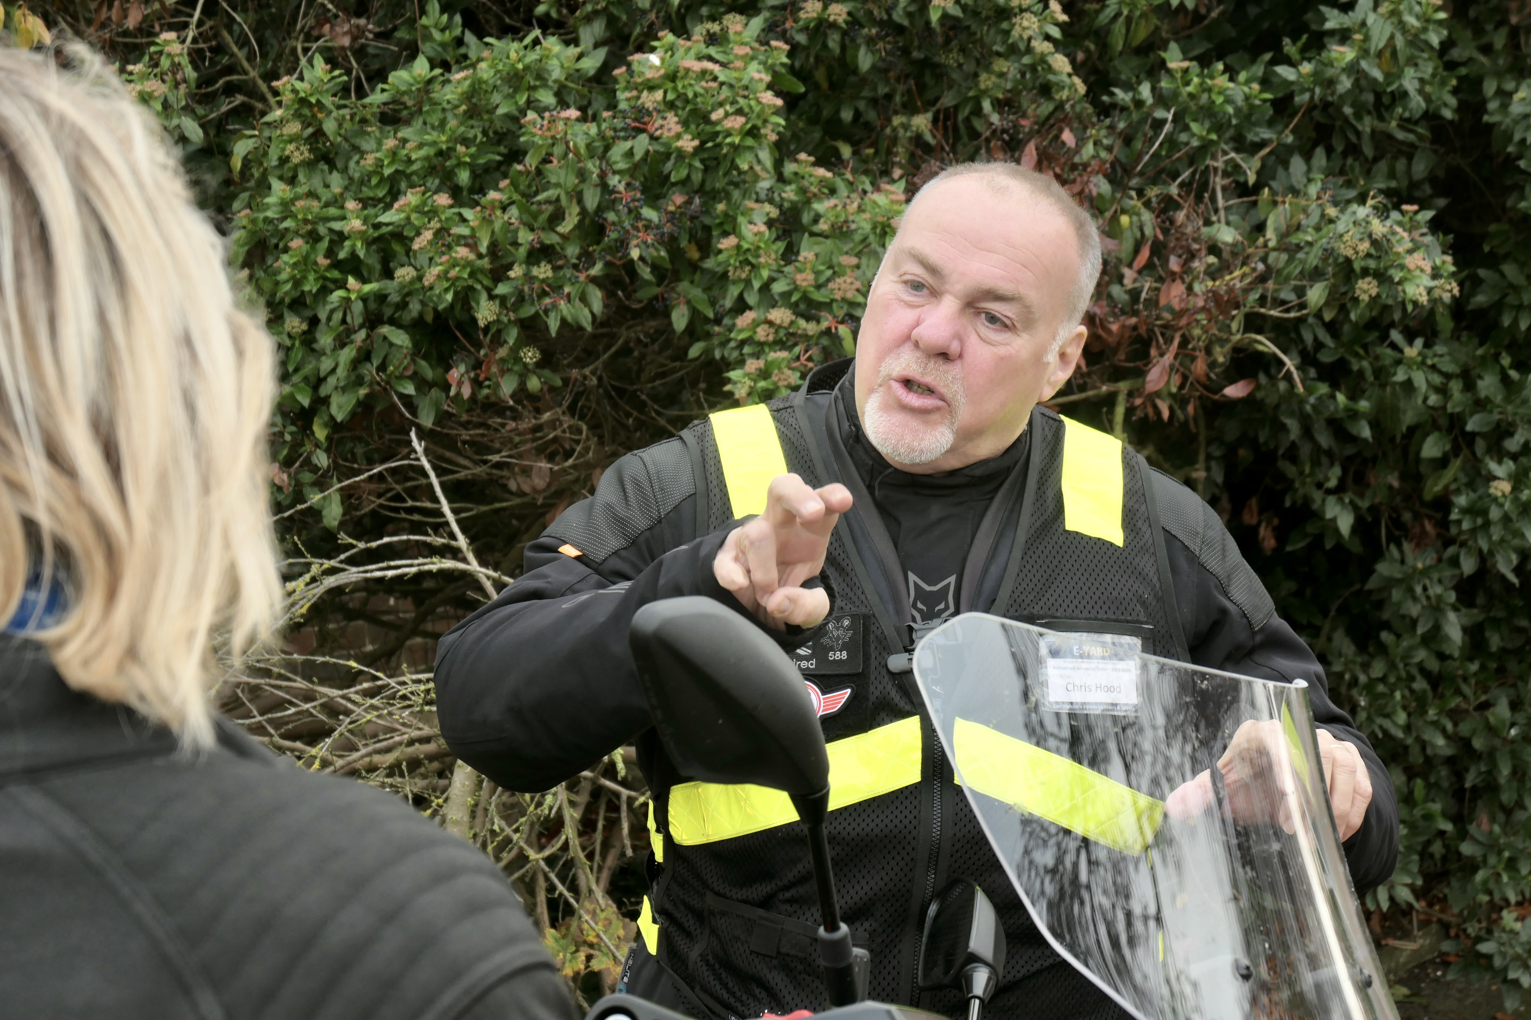

Slide 26
EDIP
Explain
Demonstrate
Imitate
Practice

Slide 27
How can andragogy and EDIP compliment each other?
Associate explains their understanding of the subject - tutor clarifies with further explanation as required, whilst treating the associate as an equal.
Allows associate’s to show prior learning/experience and gives opportunity to ensure they see the need to have/use this knowledge.
This discussion allows them to feel engaged and an actively collaborating participant, whilst giving opportunity to steer the learning as they feel best benefits.
We can take this first opportunity to address any ideas, concerns and expectations.
Tutor demonstrates in a real world situation.
Gives authentic real-world learning experiences.
The task based activity allows the associate to figure things out for themselves.

Slide 28
Associate imitates on the road - tutor gives positive encouraging feedback.
Gives further opportunity to show knowledge and capability.
Feedback given positively ensures the associate feels capable, even if they are not quite where they eventually need to be.
If they feel incapable the may give up on learning.
By encouraging participation in their own feedback they will feel self empowered.
Associate further practices utilising prior learning, with tutor input as required to improve.
With their attention now captured and the need for learning understood the associate can now set about improving their skills. Appropriate tutelage will allow them to feel appreciated, valued and respected.

Slide 29
Andragogy
Vs
Heutagogy

Slide 30
Heutagogy
Heuta=to discover gogy=leader
“Leading oneself to discovery.”
Self determined learning such as at university, where in depth reading around a wide area of knowledge is required, rather than a specific syllabus with pointed learning and assessment.
This is ideal for post test/tutors. YOU should read/learn around the wider subject of riding and/or driving and become the expert you think you should be. Knowledge and skills do not stop at RC and HWC.

