Slide 1


2025/2026
Tutor Training Programme – Conversion Course

Slide 2
House keeping
Emergency Exits in case of evacuation
Toilets
Mobile Phones
No Smoking
Drinks/Food

Slide 3
What is a Tutor?
A tutor is a person who provides assistance or tutelage to one or more people on certain subject areas or skills. The tutor spends a few hours on a daily, weekly, or monthly basis to transfer their expertise on the topic or skill to the student. Tutoring can take place in different settings, such as a classroom, a formal tutoring centre, or the home of the tutor/learner. As a teaching-learning method, tutoring is characterized by how it differs from formal teaching methods on the basis of the (in)formality of the setting as well as the flexibility in pedagogical methods in terms of duration, pace of teaching, evaluation and tutor-tutee rapport.

Slide 4
What makes a good Tutor?
Patience
Skill
Knowledge
Ability to teach
Able to put people at ease
Honesty
Maturity
Persistence
Commonsense
Morality
Flexibility
Passion
Communication
Notes:
Patience
Skill
Knowledge
Teaching ability
Able to put people at ease
Honesty
Maturity
Persistance
Common sense
Morality
Flexibility
Passion
Communication skills

Slide 5
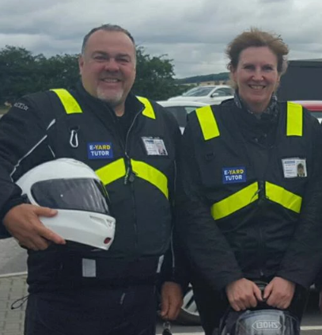
What makes a good Tutor?
First Impressions Count!
Notes:
Bike group photo
Car/Generic

Slide 6
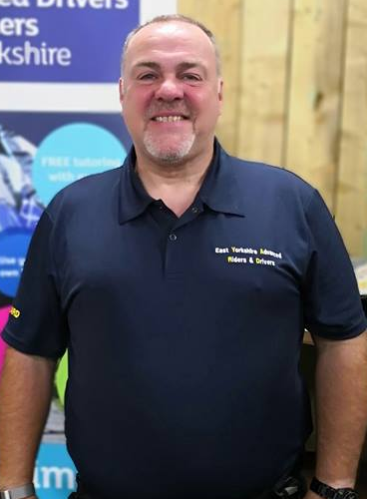
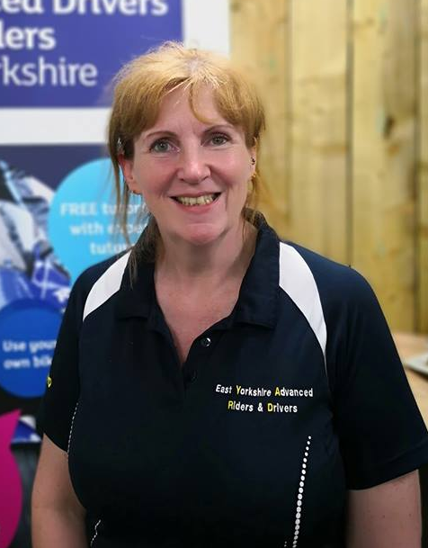
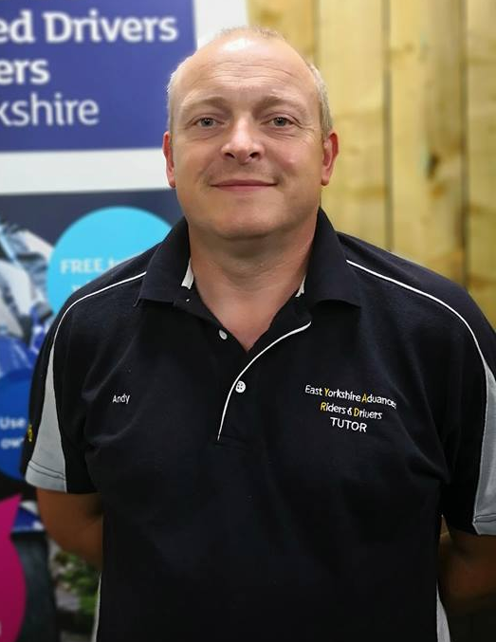
What makes a good Tutor?
First Impressions Count!
Notes:
What makes a good tutor
Coolchecker
Old Style
Dash
Spirit

Slide 7
First Contact!
ISSUE OF CLUB ATTIRE
Club attire includes Shirts, Jackets and Vests, depending on which discipline is being delivered.
Due to cost issues these items will be issued upon qualification as an approved group tutor.
We would encourage trainee tutors to purchase a group shirt, and an additional free item will be provided once qualified.
Notes:
What to say - Ask
Background - Self/Associate
Aspirations
LEGALS
Docs / Eyes

Slide 8
First Contact!
Introduction –
Brief background to establish your credentials
Ascertain Associate background and their aspirations –
Perceived strengths/development
Legal Aspects –
Documents and Eyesight checks
Notes:
What to say - Ask
Background - Self/Associate
Aspirations
LEGALS
Docs / Eyes

Slide 9
First Contact!
RIDE/DRIVE REQUIREMENTS –
Ride/Drive for yourself – Not to impress
Do nothing uncomfortable with – Don’t push
them to learn beyond their capability. Develop them
Ignore Tutor position – Explain your position re view,
control use etc.
Conduct of ride/drive – Observe all traffic signals and speed
limits particularly when considering overtakes
Separation strategy - Have an end location, ensure you have
swapped numbers, stop safely if separated etc. (bikes)
Notes:
Ask -
Ride/Drive for self
Don't push - own pace
Ignore where tutor is (bikes)
Legal - traffic light / signals / speed!!
Separation Strategy

Slide 10
First Contact!
Safety First – Tutor Safeguarding
Your personal safety is paramount.
As a tutor you are potentially meeting strangers who could be anyone.
E-YARD registration protocol records details of associate members and with the financial transaction there is a confirmation of identity.
We do however offer taster ride and drive assessments to encourage new membership.
Please consider a brief entry on Facebook, Messenger or private message/text to a nominated person with details of time of session, meet and end point – a photo when you meet up (which can be used for the blog later – don’t make it an obvious issue) is a consideration
Initial assessments should take place on main roads and debrief should be at public places such as cafes – not roadside lay-bys for example
Notes:
IMPORTANT - read and ask understanding

Slide 11
UNDERSTAND YOUR ASSOCIATES NEEDS
Neurodiversity - This can include conditions such as Dyslexia, Dyspraxia, Dyscalculia, Autism & Asperger’s, Tourette’s, ADHD and other conditions. We must recognise that those embarking on advanced driving or riding have already achieved their licence. It is important that we understand not only learning styles, but also neurodiversity, to ensure that training meets the needs of all drivers and riders. We should be focusing on developing understanding not just learning.
Most people think in lists, or take a step-by-step approach, use prompts well, make notes, learn and recite words and phrases with ease
Most people don’t think holistically or think spatially unlike those with neurodiversity conditions.
As tutors we need to talk to our associates and gain an understanding of what works for them, focus on the appropriate learning style, and build understanding rather than knowledge
Notes:
IMPORTANT - read and ask understanding

Slide 12
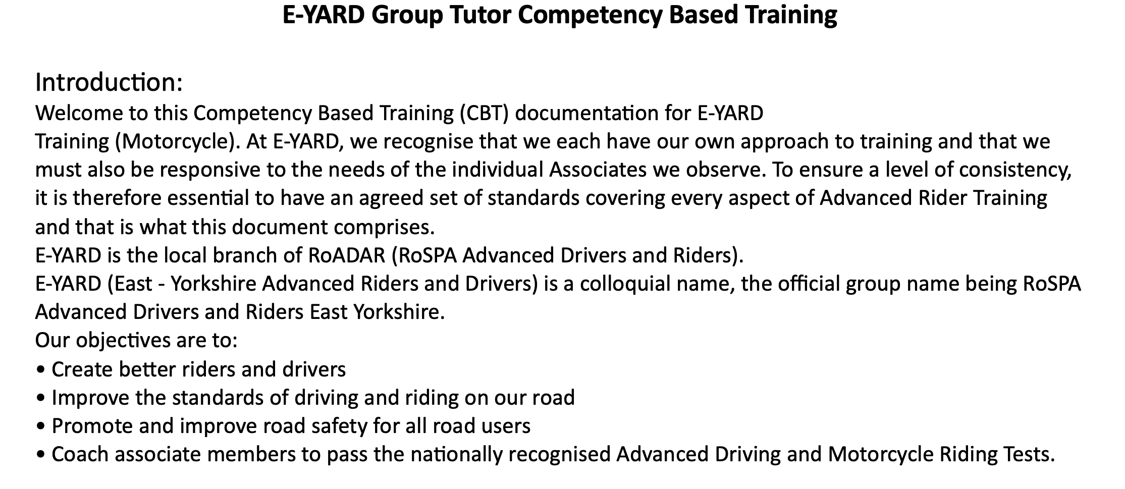

Slide 13


Slide 14


Slide 15
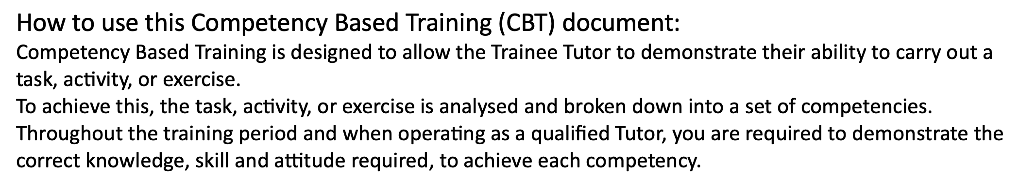

Slide 16
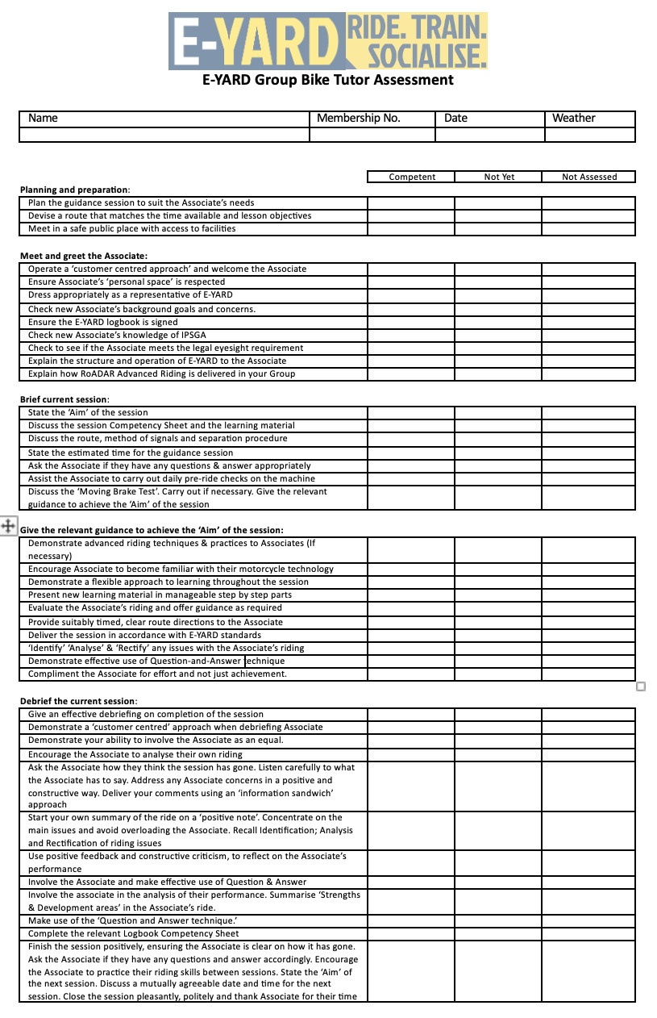


Slide 17
:
Give an effective debriefing on completion of the session
Demonstrate a ‘customer centred’ approach when debriefing Associate
Demonstrate your ability to involve the Associate as an equal.
Encourage the Associate to analyse their own driving
Ask the Associate how they think the session has gone. Listen carefully to what the Associate has to say. Address any Associate concerns in a positive and constructive way. Deliver your comments using an ‘information sandwich’ approach
Start your own summary of the drive on a ‘positive note’. Concentrate on the main issues and avoid overloading the Associate. Recall Identification; Analysis and Rectification of driving issues
Use positive feedback and constructive criticism, to reflect on the Associate’s performance
Involve the Associate and make effective use of Question & Answer
Involve the associate in the analysis of their performance. Summarise ‘Strengths & Development areas’ in the Associate’s drive.
Make use of the ‘Question and Answer technique.’
Complete the relevant Logbook Competency Sheet
Finish the session positively, ensuring the Associate is clear on how it has gone. Ask the Associate if they have any questions and answer accordingly. Encourage the Associate to practice their riding skills between sessions. State the ‘Aim’ of the next session. Discuss a mutually agreeable date and time for the next session. Close the session pleasantly, politely and thank Associate for their time

Slide 18
Any Questions?

Slide 19
Comfort Break Time

Slide 20
Training Logs

Slide 21
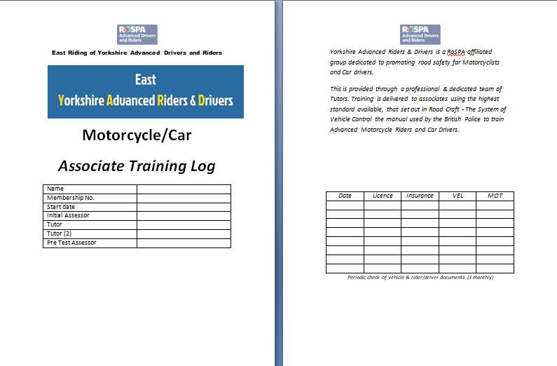
Training Logs
Notes:
Log owners details. Important to record who is the Assessor/Tutor. Check documents still in force tri-monthly

Slide 22
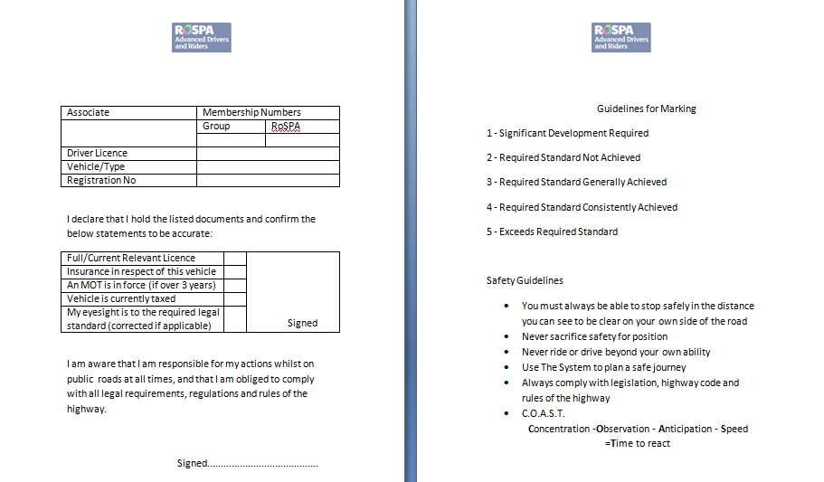
Training Logs
Notes:
Full name. Group number is Year of joining and sequential 3 figure number issued membership sec. Type = car / bike. Check drivers licence and other documents. Check eyesight – 20m. Candidate to sign both boxes. Countersign doc checks.

Slide 23
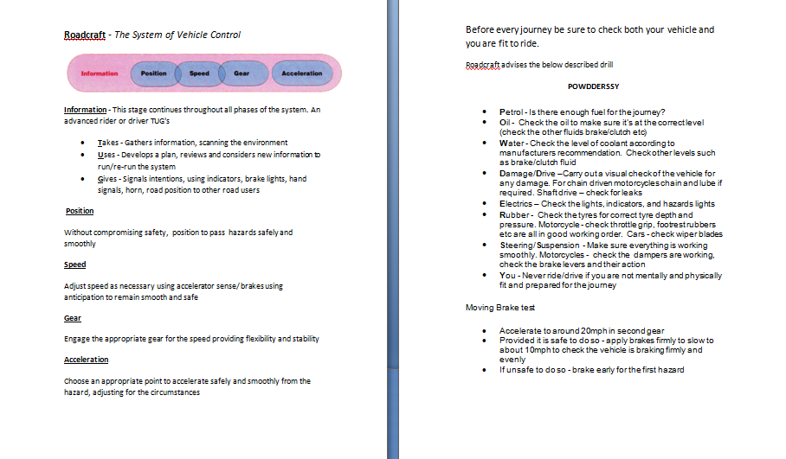
Training Logs
Notes:
Basic reminders of IPSGA / POWDERS / Brake test

Slide 24
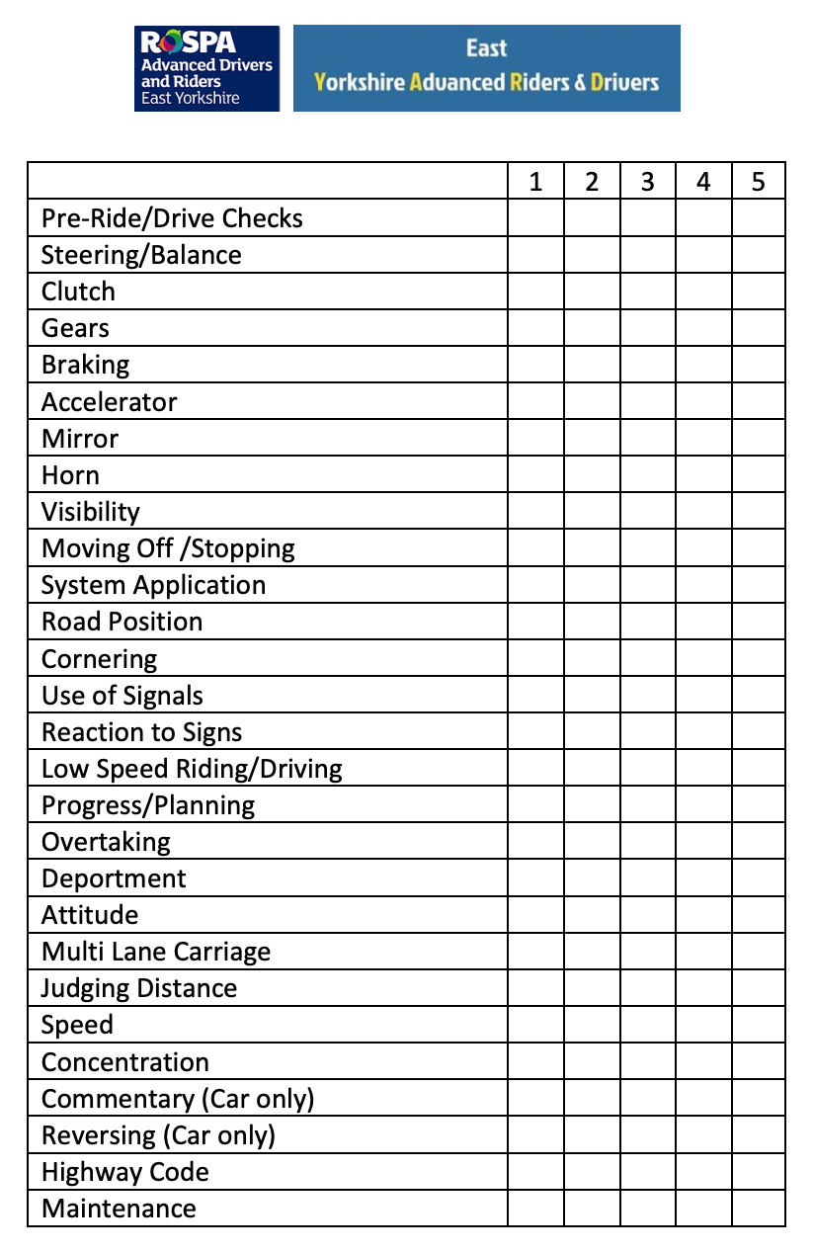
Notes:
What’s wrong with this running log? The candidate should be an examiner?!! Marking like this leaves no room for development.

Slide 25
Guidelines for marking
1 - Significant Development Required
2 - Required standard not achieved
3 - Required Standard Generally Achieved
4 - Required Standard Consistently Achieved
5 - Exceeds Required Standard
E-YARD logbooks will re-designed, to reflect this on the next print run. This may be a while due to stock currently held.
Please amend your stock accordingly.
Notes:
Delete columns 1 & 5. Associates are

Slide 26
Training Logs
When assessing the grade to award remember these are not ‘Happy Sheets’
Encourage the associate to review their own ride/drive and get them to ‘mark themselves’.
Just because they get something correct once, it doesn’t mean they understand and will always deliver appropriately.
Do not award high marks as a reward
Consistency, Consistency, Consistency
Once is an incidence
Twice is a coincidence
Three times is starting to show a pattern – both positive and requiring development
Notes:
Not a Happy Sheet. Be honest. Candidate needs to know where strengths / weaknesses are. 1 & 2 will be initial assessment. Gaining weighted to 3 = bronze, 4 = silver, 5 = gold Do not say as such as may give false expectation. Free writing in comments area. No need to match line for line. Both to sign at time of de-brief. 28 areas match those of the examiners manual

Slide 27
Commend - Recommend - Commend
Associates are all Volunteers!
Every Ride or Drive will have Positives and Negatives
Observe a Positive – i.e. ‘Safe Drive’
Deal with ONE issue
End on a General Positive
Notes:
Every ride / drive will have ups and downs
General positive
Deal one issue - May be mini P-C-P in waves
End on positive

Slide 28
Bite Size Chunks
Identify One Main Issue
Ask Associate to Review their own performance
Commend - Recommend - Commend
Having Identified Issue to Associate deal with it for no longer than 5 – 10 minutes
Remember to finish on the Positive!
Notes:
ID major issue and concentrate on that. No more than 10 minutes discussion
Review their own performance
P-C-P
5 - 10 min max

Slide 29
Lesson Planning
Lesson Length
No more than TWO HOURS is advised
Maximum 45 minutes between stops for debrief
Associates will be concentrating very hard and will become tired. 45 minutes will be the longest an associate will be able to safely concentrate.
Look for signs – poor position, comfort braking, loss of progress, fidgeting, leg stretching (motorcycles)
Notes:
2 hrs max advised
45 mins per section
Tiredness
Look for signs

Slide 30
Lesson Planning
Have Rules!
Motorcyclists
Exchange Phone Numbers
Coms fitted? Use for BASIC input i.e. Directions or ‘one word’ instruction
Agree route – Comfort break. Final Destination.
Consider appropriate stops – hard standing? Cafe? Avoid gravel/potholes/ busy lay-bys
If separated agree system – Stop when safe. Don’t block entrances/bus stops etc.
Notes:
Identify from previous records or choose most important / dangerous. No more than 2 hours. Max 45 minutes before stop. Consider stop place – make appropriate / safe – cafe, hard standing, lay-by – no gravel / potholes.

Slide 31
Feedback
How?
What?
Why?
When?
OPEN QUESTIONS
Notes:
Always ask OPEN questions
Who - Why - What - Where - When - How

Slide 32
Comms

Slide 33
Pre Test Assessments

Slide 34
Pre Test Assessments
Why do we conduct Pre Test Asssessment (PTA’s)?
Assess suitability for test readiness
Give feedback from an independent assessor
‘Nit-pick’ minor development issues to raise standard
Give Guidance to achieve a polished performance
Familiarise associate with how a test is conducted and what to expect on the big day

Slide 35
Pre Test Assessments
How do we conduct Pre Test Assessment (PTA’s)?
When the Tutor feels the Associate is test ready they should contact the Training Officer to arrange.
The associate will be contacted directly to arrange a mutually suitable appointment

Slide 36
Pre Test Assessments
How do we conduct Pre Test Assessment (PTA’s)?
The assessment will be conducted in as near as possible Test Conditions - Comprising:
1. Briefing
2. Questions on RoadCraft/Highway Code
3. Practical riding demonstration
4. Debrief and feedback

Slide 37
Pre Test Assessments
How do we conduct Pre Test Assessment (PTA’s)?
A report will be generated for the benefit of the Associate and their Tutor. This will be sent to them for their records and attention. A copy will be forwarded to the training officer for E-YARD records.

Slide 38
Pre Test Assessments
The documentation for PTA’s is designed to mirror the RoADAR Examiners Test Report.
It utilises a matrix style marking system, covering 30 categories with descriptive phrases generated to highlight performance

Slide 39
Pre Test Assessments
These are then supplemented with a free text report under “OVERALL COMMENTS”

Slide 40
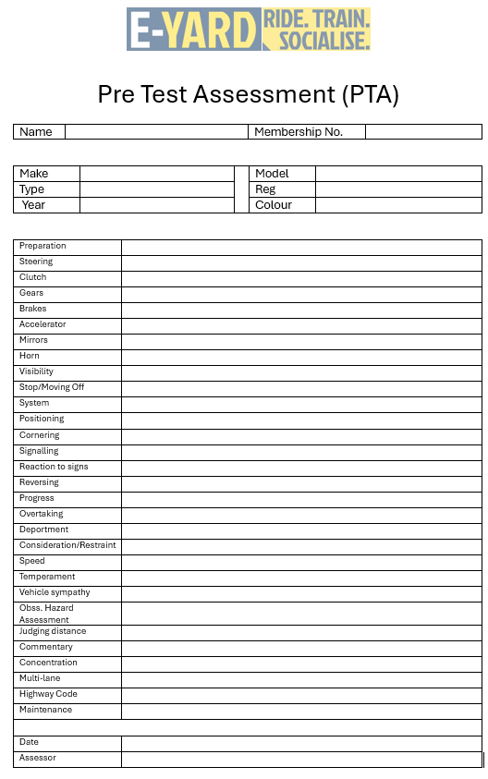
Pre Test Assessments
Pre Test Assessment document template can be found on the ‘Training Documents’ tab on the website.

Slide 41
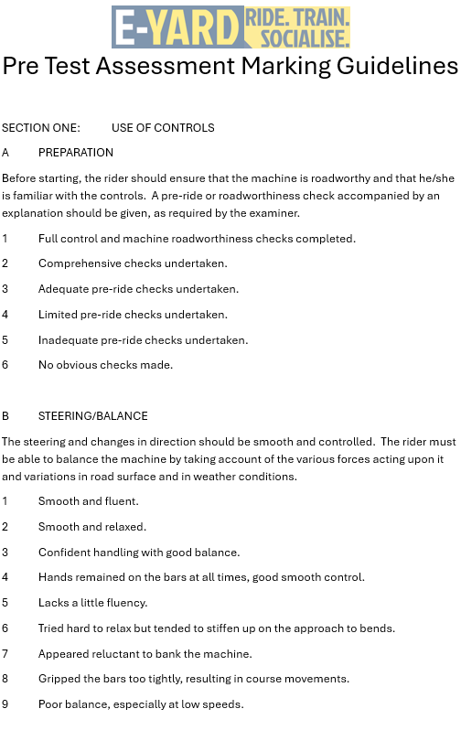
Pre Test Assessments
Pre Test Assessment Marking Guidelines document template can be found on the ‘Training Documents’ tab on the website.

Slide 42
Any Questions?

