Slide 1


2026/2027
Tutor Training Programme – Conversion Course

Slide 2
HOUSEKEEPING
Emergency Exits in case of evacuation
Toilets
Mobile Phones
No Smoking
Drinks/Food

Slide 3
What is a Tutor?
.

Slide 4
A tutor is a person who provides assistance or tutelage to one or more people on certain subject areas or skills. The tutor spends a few hours on a daily, weekly, or monthly basis to transfer their expertise on the topic or skill to the student. Tutoring can take place in different settings, such as a classroom, a formal tutoring centre, or the home of the tutor/learner. As a teaching-learning method, tutoring is characterized by how it differs from formal teaching methods on the basis of the (in)formality of the setting as well as the flexibility in pedagogical methods in terms of duration, pace of teaching, evaluation and tutor-tutee rapport.

Slide 5
What makes a good Tutor?
Patience
Skill
Knowledge
Ability to teach
Able to put people at ease
Honesty
Maturity
Persistence
Commonsense
Morality
Flexibility
Passion
Communication
Notes:
Patience
Skill
Knowledge
Teaching ability
Able to put people at ease
Honesty
Maturity
Persistance
Common sense
Morality
Flexibility
Passion
Communication skills

Slide 6
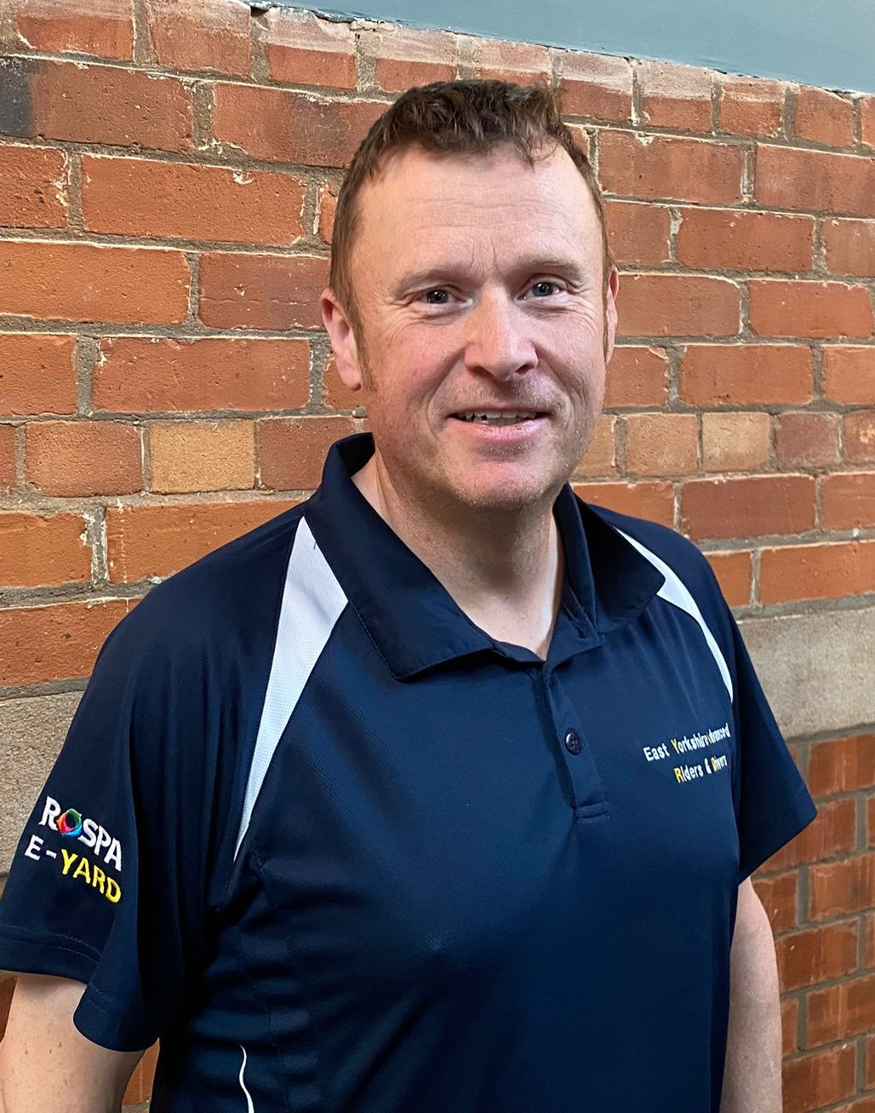
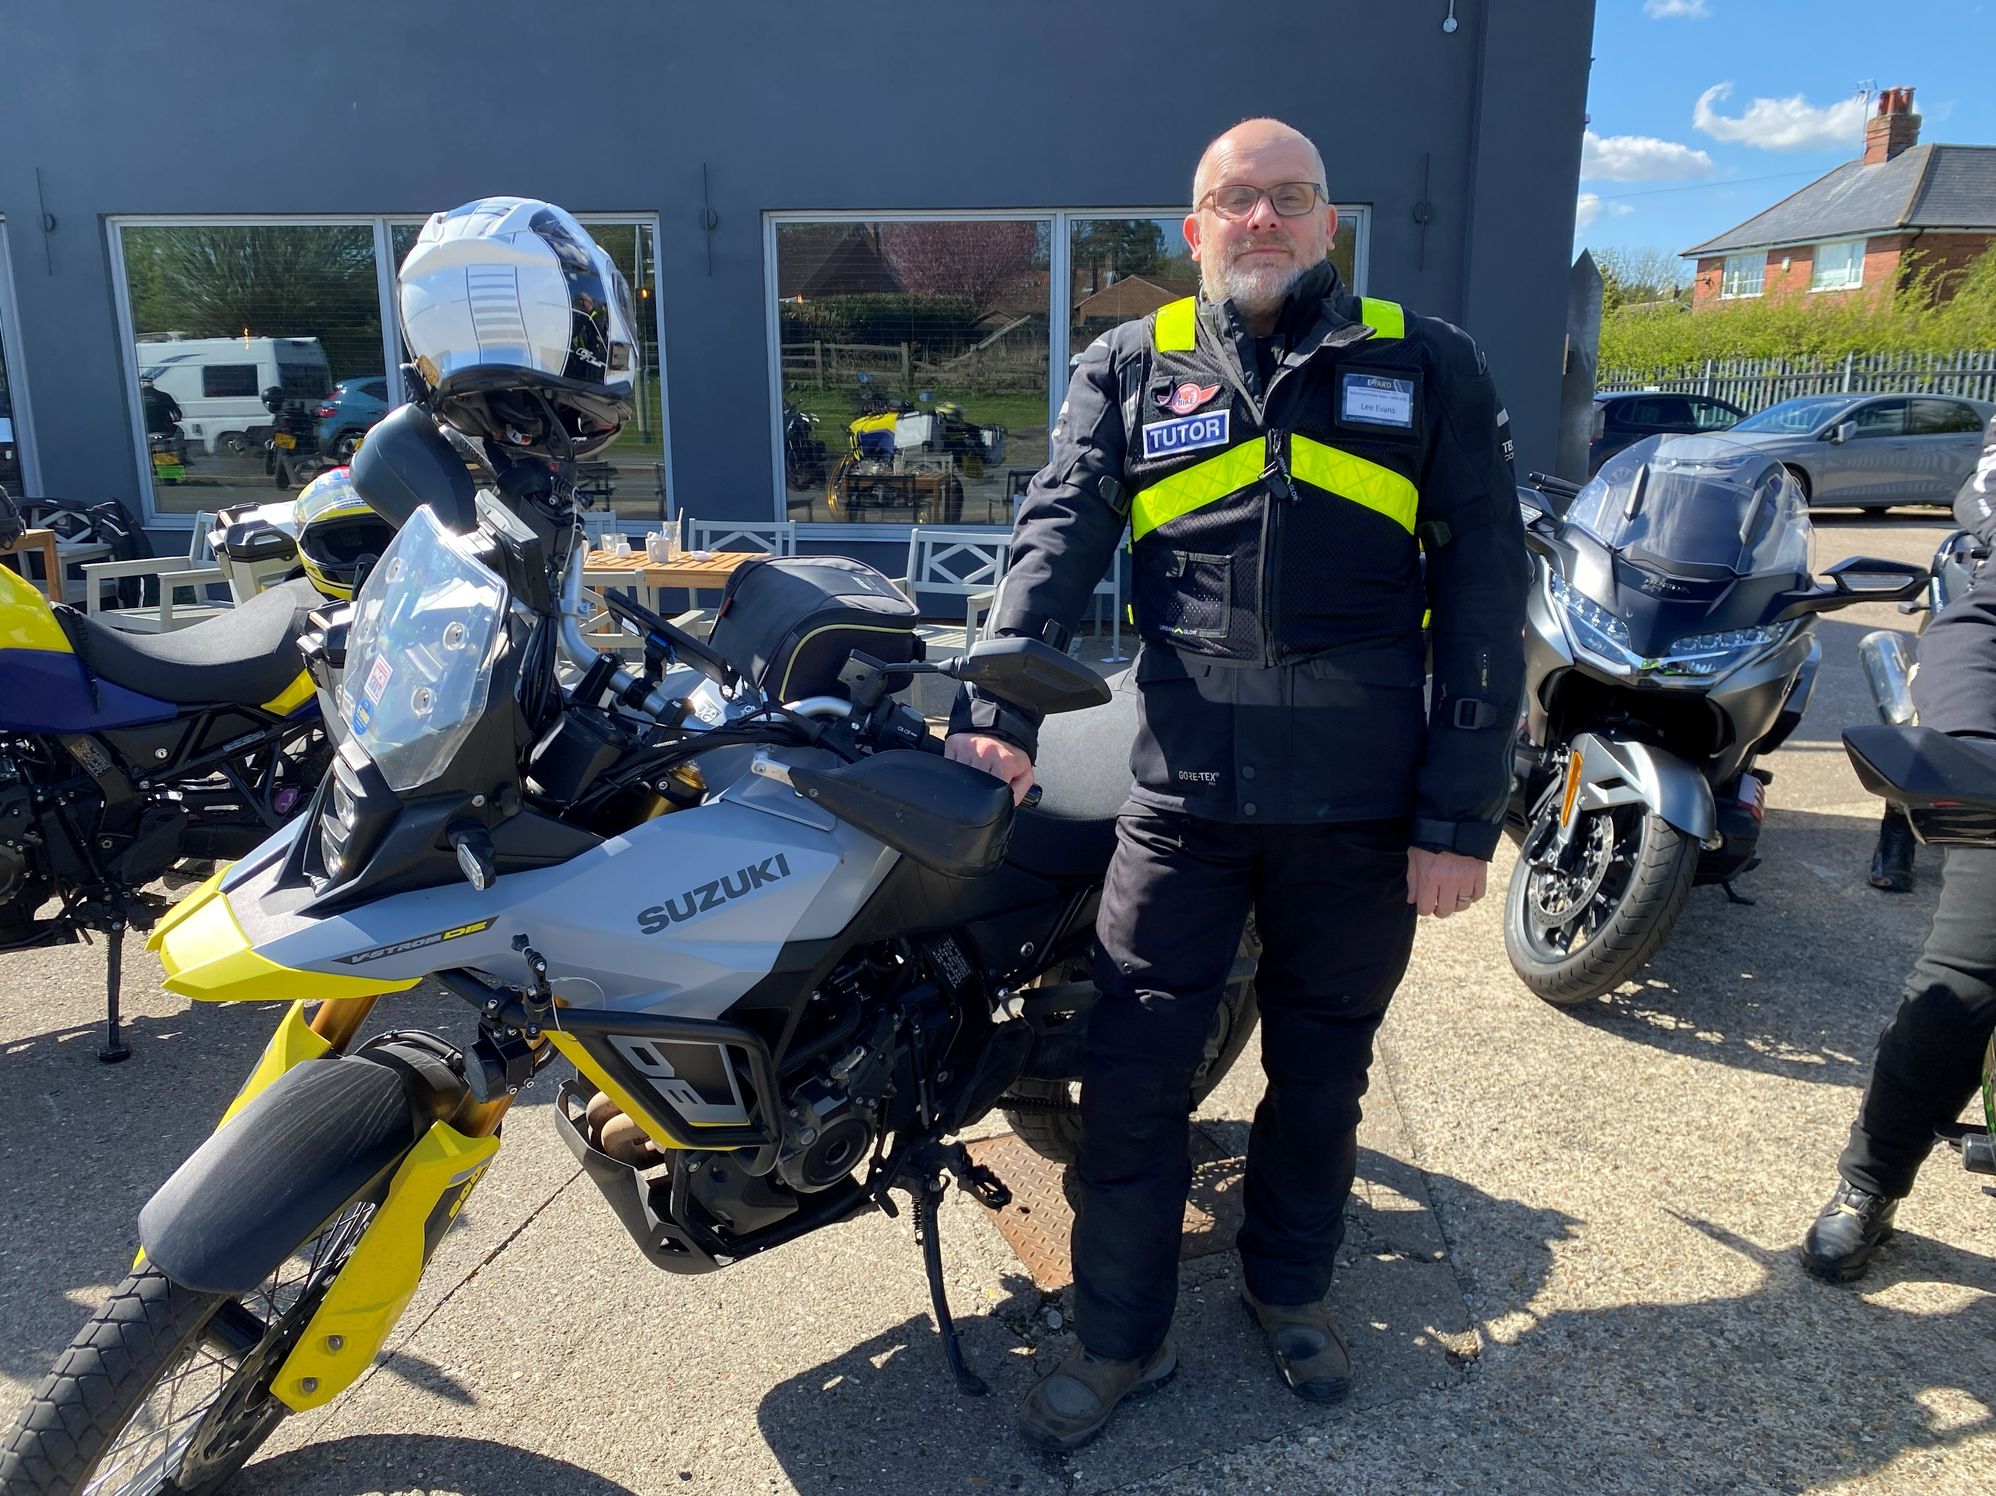
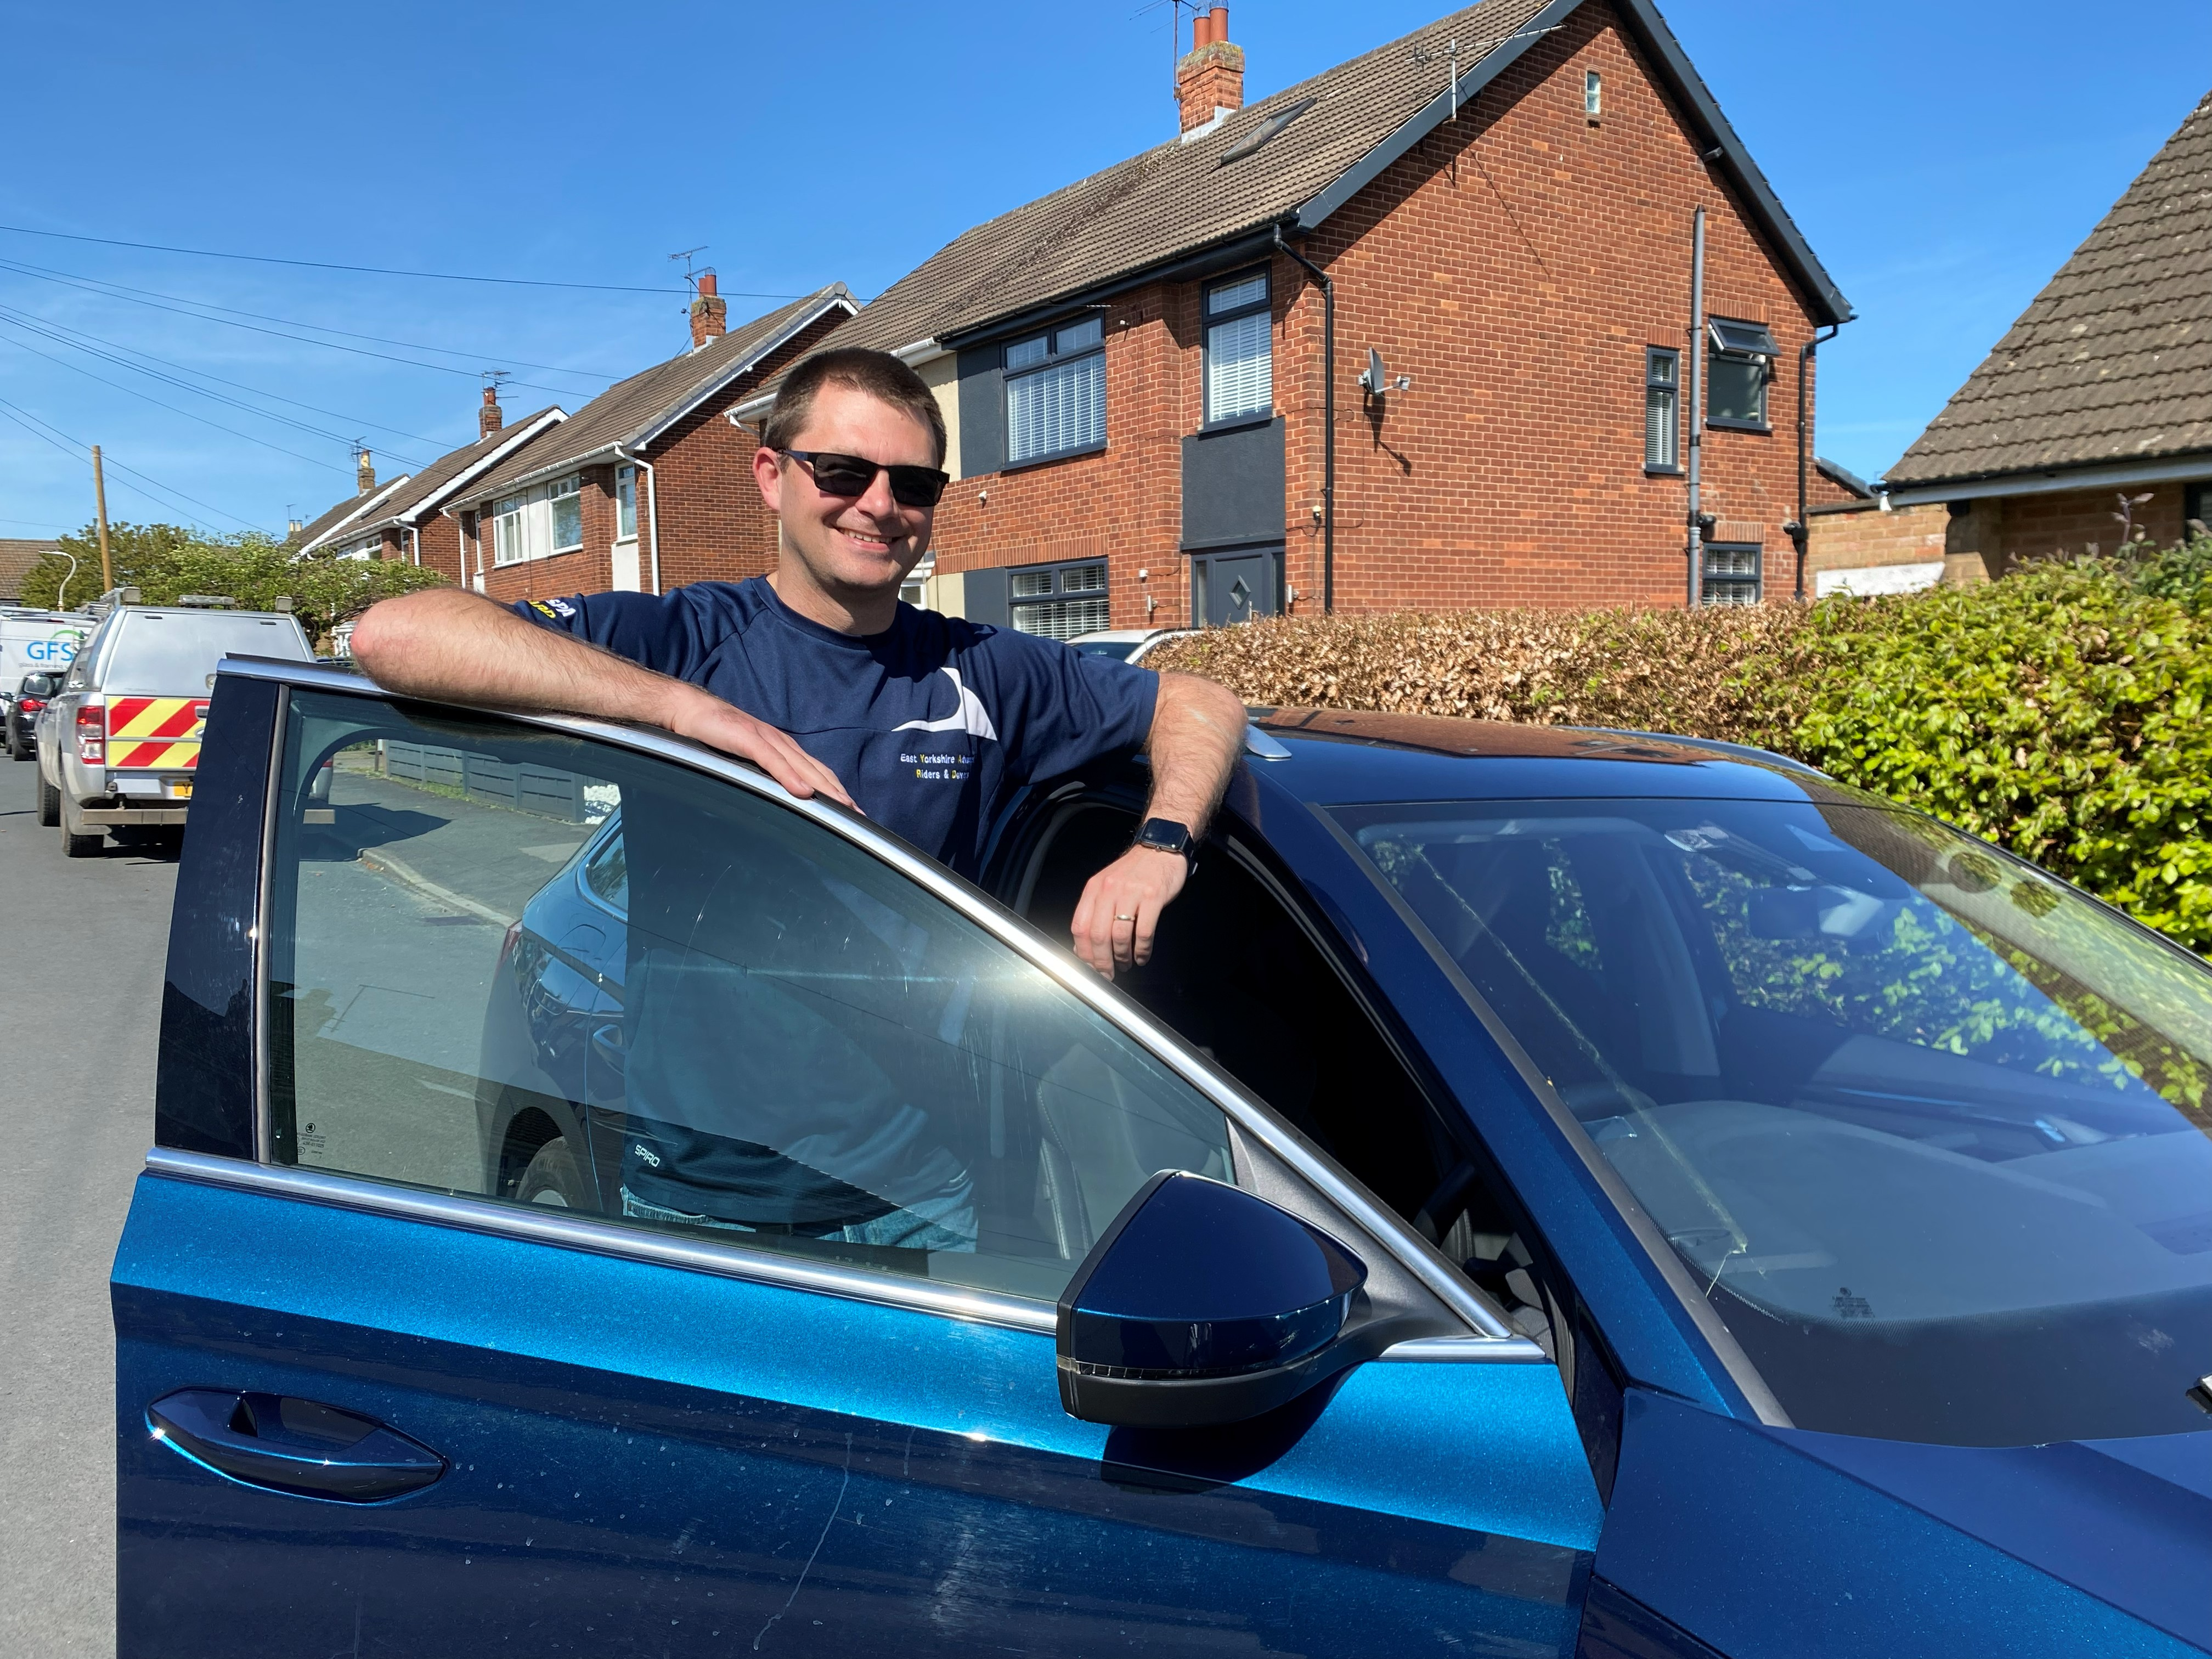
What makes a good Tutor?
First Impressions Count!
Notes:
Bike group photo
Car/Generic

Slide 7
First Contact!
ISSUE OF CLUB ATTIRE
Club attire includes Shirts, Jackets and Vests, depending on which discipline is being delivered.
Due to cost issues these items will be issued upon qualification as an approved group tutor.
We would encourage trainee tutors to purchase a group shirt, and an additional free item will be provided once qualified.
Notes:
What to say - Ask
Background - Self/Associate
Aspirations
LEGALS
Docs / Eyes

Slide 8
First Contact!
Introduction –
Brief background to establish your credentials
Ascertain Associate background and their aspirations –
Perceived strengths/development
Legal Aspects –
Documents and Eyesight checks
Notes:
What to say - Ask
Background - Self/Associate
Aspirations
LEGALS
Docs / Eyes

Slide 9
First Contact!
RIDE/DRIVE REQUIREMENTS –
Ride/Drive for yourself – Not to impress
Do nothing uncomfortable with – Don’t push
them to learn beyond their capability. Develop them
Ignore Tutor position – Explain your position re view,
control use etc.
Conduct of ride/drive – Observe all traffic signals and speed
limits particularly when considering overtakes
Separation strategy - Have an end location, ensure you have
swapped numbers, stop safely if separated etc. (bikes)
Notes:
Ask -
Ride/Drive for self
Don't push - own pace
Ignore where tutor is (bikes)
Legal - traffic light / signals / speed!!
Separation Strategy

Slide 10
Safety First – Tutor Safeguarding
Your personal safety is paramount.
As a tutor you are potentially meeting strangers who could be anyone.
E-YARD registration protocol records details of associate members and with the financial transaction there is a confirmation of identity.
We do however offer taster ride and drive assessments to encourage new membership.
Initial assessments should take place on main roads and debrief should be at public places such as cafes – not roadside lay-bys for example
Notes:
IMPORTANT - read and ask understanding

Slide 11
UNDERSTAND YOUR ASSOCIATES NEEDS
Neurodiversity can include conditions such as Dyslexia, Dyspraxia, Dyscalculia, Autism & Asperger’s, Tourette’s, ADHD and other conditions.
It is important that we understand not only learning styles, but also neurodiversity, to ensure that training meets the needs of all drivers and riders. We should be focusing on developing understanding not just learning.
As tutors we need to talk to our associates and gain an understanding of what works for them, focus on the appropriate learning style, and build understanding rather than just knowledge
Notes:
IMPORTANT - read and ask understanding

Slide 13
UNDERSTAND YOUR ASSOCIATES NEEDS
Neurodiversity can include conditions such as Dyslexia, Dyspraxia, Dyscalculia, Autism & Asperger’s, Tourette’s, ADHD and other conditions.
It is important that we understand not only learning styles, but also neurodiversity, to ensure that training meets the needs of all drivers and riders. We should be focusing on developing understanding not just learning.
As tutors we need to talk to our associates and gain an understanding of what works for them, focus on the appropriate learning style, and build understanding rather than just knowledge
Notes:
IMPORTANT - read and ask understanding

Slide 14
Any Questions?

Slide 15
Comfort Break Time

Slide 16
Adult Learning!

Slide 17
Training Logs

Slide 18
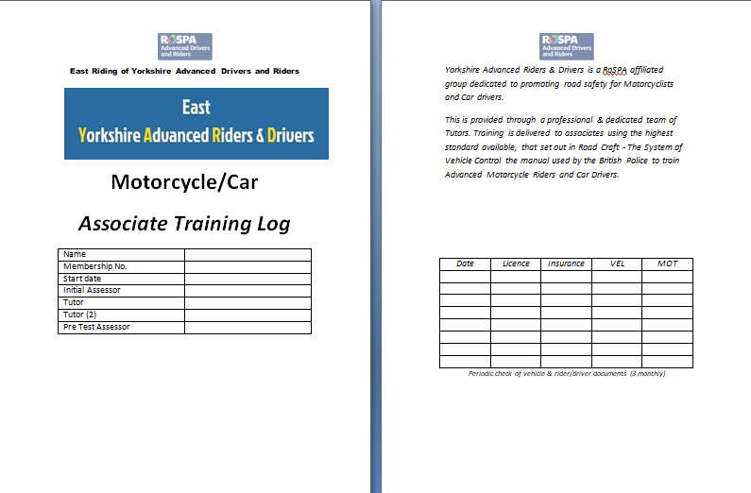
Training Logs
Notes:
Log owners details. Important to record who is the Assessor/Tutor. Check documents still in force tri-monthly

Slide 19
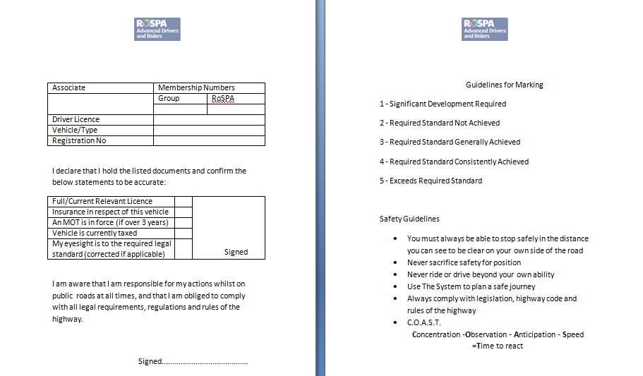
Training Logs
Notes:
Full name. Group number is Year of joining and sequential 3 figure number issued membership sec. Type = car / bike. Check drivers licence and other documents. Check eyesight – 20m. Candidate to sign both boxes. Countersign doc checks.

Slide 20
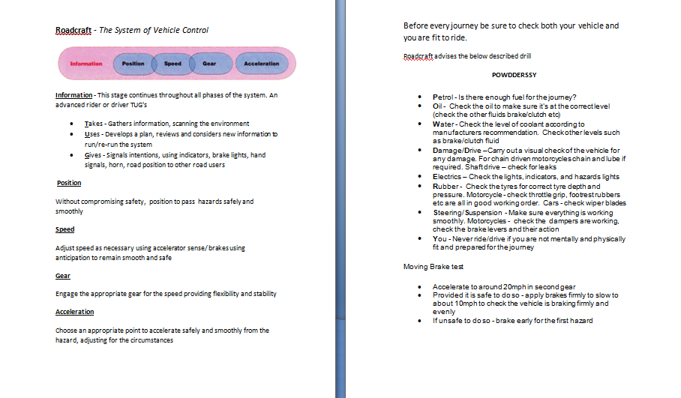
Training Logs
Notes:
Basic reminders of IPSGA / POWDERS / Brake test

Slide 21
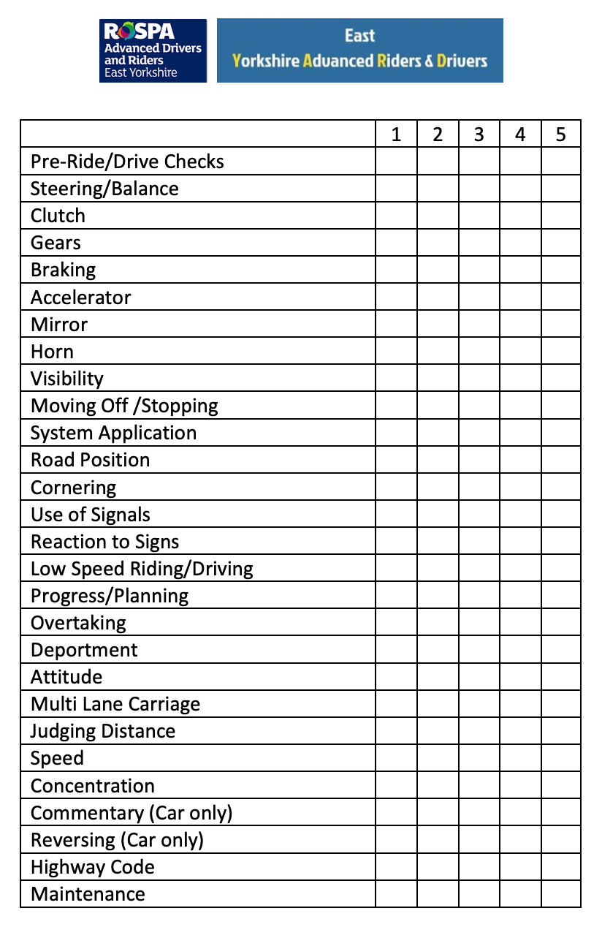
Notes:
What’s wrong with this running log? The candidate should be an examiner?!! Marking like this leaves no room for development.

Slide 22
Guidelines for marking
1 - Significant Development Required
2 - Required standard not achieved
3 - Required Standard Generally Achieved
4 - Required Standard Consistently Achieved
5 - Exceeds Required Standard
E-YARD logbooks will re-designed, to reflect this on the next print run. This may be a while due to stock currently held.
Please amend your stock accordingly.
Notes:
Delete columns 1 & 5. Associates are

Slide 23
Training Logs
When assessing the grade to award remember these are not ‘Happy Sheets’
Encourage the associate to review their own ride/drive and get them to ‘mark themselves’.
Just because they get something correct once, it doesn’t mean they understand and will always deliver appropriately.
Do not award high marks as a reward
Consistency, Consistency, Consistency
Once is an incidence
Twice is a coincidence
Three times is starting to show a pattern – both positive and requiring development
Notes:
Not a Happy Sheet. Be honest. Candidate needs to know where strengths / weaknesses are. 1 & 2 will be initial assessment. Gaining weighted to 3 = bronze, 4 = silver, 5 = gold Do not say as such as may give false expectation. Free writing in comments area. No need to match line for line. Both to sign at time of de-brief. 28 areas match those of the examiners manual

Slide 24
Commend - Recommend - Commend
Associates are all Volunteers!
Every Ride or Drive will have Positives and Negatives
Observe a Positive – i.e. ‘Safe Drive’
Deal with ONE issue
End on a General Positive
Notes:
Every ride / drive will have ups and downs
General positive
Deal one issue - May be mini P-C-P in waves
End on positive

Slide 25
Bite Size Chunks
Identify One Main Issue
Ask Associate to Review their own performance
Commend - Recommend - Commend
Having Identified Issue to Associate deal with it for no longer than 5 – 10 minutes
Remember to finish on the Positive!
Notes:
ID major issue and concentrate on that. No more than 10 minutes discussion
Review their own performance
P-C-P
5 - 10 min max

Slide 26
Lesson Planning
Lesson Length
No more than TWO HOURS is advised
Maximum 45 minutes between stops for debrief
Associates will be concentrating very hard and will become tired. 45 minutes will be the longest an associate will be able to safely concentrate.
Look for signs – poor position, comfort braking, loss of progress, fidgeting, leg stretching (motorcycles)
Notes:
2 hrs max advised
45 mins per section
Tiredness
Look for signs

Slide 27
Lesson Planning
Have Rules!
Motorcyclists
Exchange Phone Numbers
Coms fitted? Use for BASIC input i.e. Directions or ‘one word’ instruction
Agree route – Comfort break. Final Destination.
Consider appropriate stops – hard standing? Cafe? Avoid gravel/potholes/ busy lay-bys
If separated agree system – Stop when safe. Don’t block entrances/bus stops etc.
Notes:
Identify from previous records or choose most important / dangerous. No more than 2 hours. Max 45 minutes before stop. Consider stop place – make appropriate / safe – cafe, hard standing, lay-by – no gravel / potholes.

Slide 28
Comfort Brake Time
Notes:
Identify from previous records or choose most important / dangerous. No more than 2 hours. Max 45 minutes before stop. Consider stop place – make appropriate / safe – cafe, hard standing, lay-by – no gravel / potholes.

Slide 29

Tutor Training
Getting the most out of our associates and tutors.

Slide 30
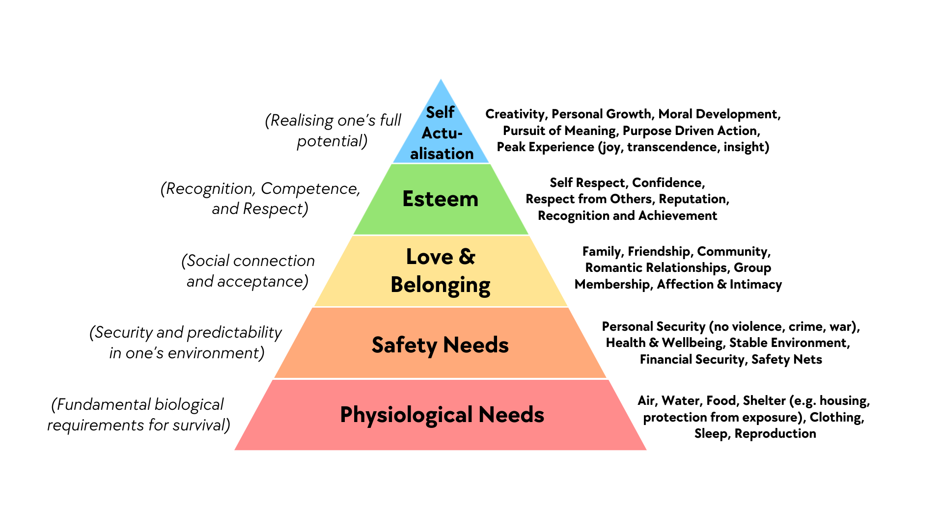

Slide 31
Safety needs go far beyond physical safety.
Get the environment right for learning.
Expose your own weaknesses
Make it crystal clear that we do not judge
Be very careful with questions – put yourself in your associate’s position.
Never over-react or show frustration. Your associate chose to be here…
Read the body language – the ‘deportment’.
Make the focus of questions the associate, rather than the drive…

Slide 32
How do you think that went?
What are you subconsciously saying to your associate when you ask this question?
How does you associate feel when you ask this question?

Slide 33
I love the roads around here! Were you happy with your ride?
What are you subconsciously saying to your associate when you put it like this?
How does you associate feel when you ask this question?

Slide 34
What was the subtle difference?
Focus on the rider/driver; not the ride/drive.
Give an opinion to take the fear of judgement away.
Allows you to move onto the more focused discussion without fear.

Slide 35
How was your cornering today?
Subconscious response: ‘There was something wrong with my cornering today. I’d better say it was rubbish. I knew I’d get it all wrong!’

Slide 36
I gave you some really nasty bends today – you can clearly get round them! How did you plan for them?
You have the information you need for next steps
The associate is not feeling judged
The system is being thought about subconsciously within the context.
The dialogue is open for giving advice.

Slide 37
Create a starting statement/question for the following contexts:
The associate has made a ‘swan-neck’ unsafe overtake with a junction to the right, hidden by a hedge.
The associate has been riding/driving in P2 for the last 10 minutes with no hint of changing it.
The associate has made no head movements – you don’t think they are checking mirrors or gathering enough information.

Slide 38
Information Overload:
https://www.youtube.com/watch?v=J1p5zOM96f0&list=RDJ1p5zOM96f0&start_radio=1

Slide 39
Feedback
How?
What?
Why?
When?
OPEN QUESTIONS
Notes:
Always ask OPEN questions
Who - Why - What - Where - When - How

Slide 40
Comms

Slide 41
Pre Test Assessments

Slide 42
Pre Test Assessments
Why do we conduct Pre Test Asssessment (PTA’s)?
Assess suitability for test readiness
Give feedback from an independent assessor
‘Nit-pick’ minor development issues to raise standard
Give Guidance to achieve a polished performance
Familiarise associate with how a test is conducted and what to expect on the big day

Slide 43
Pre Test Assessments
How do we conduct Pre Test Assessment (PTA’s)?
When the Tutor feels the Associate is test ready they should contact the Training Officer to arrange.
The associate will be contacted directly to arrange a mutually suitable appointment

Slide 44
Pre Test Assessments
How do we conduct Pre Test Assessment (PTA’s)?
The assessment will be conducted in as near as possible Test Conditions - Comprising:
1. Briefing
2. Questions on RoadCraft/Highway Code
3. Practical riding demonstration
4. Debrief and feedback

Slide 45
Pre Test Assessments
How do we conduct Pre Test Assessment (PTA’s)?
A report will be generated for the benefit of the Associate and their Tutor. This will be sent to them for their records and attention. A copy will be forwarded to the training officer for E-YARD records.

Slide 46
Pre Test Assessments
The documentation for PTA’s is designed to mirror the RoADAR Examiners Test Report.
It utilises a matrix style marking system, covering 30 categories with descriptive phrases generated to highlight performance

Slide 47
Pre Test Assessments
These are then supplemented with a free text report under “OVERALL COMMENTS”

Slide 48
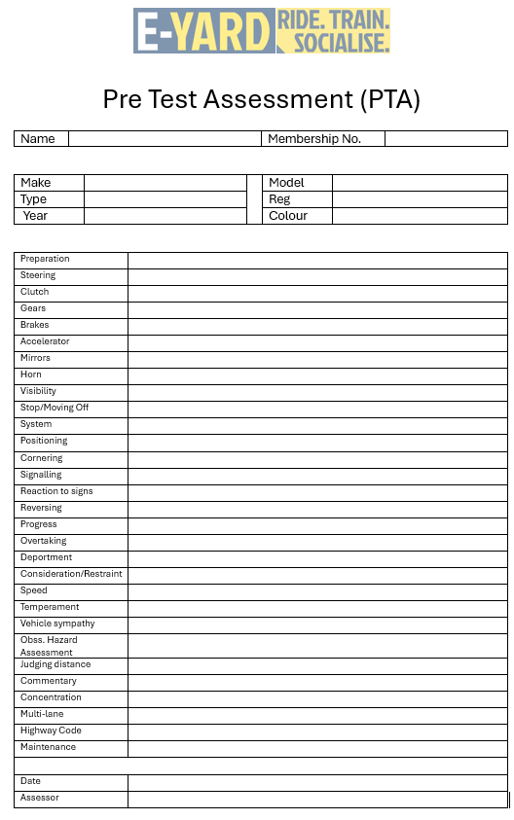
Pre Test Assessments
Pre Test Assessment document template can be found on the ‘Training Documents’ tab on the website.

Slide 49
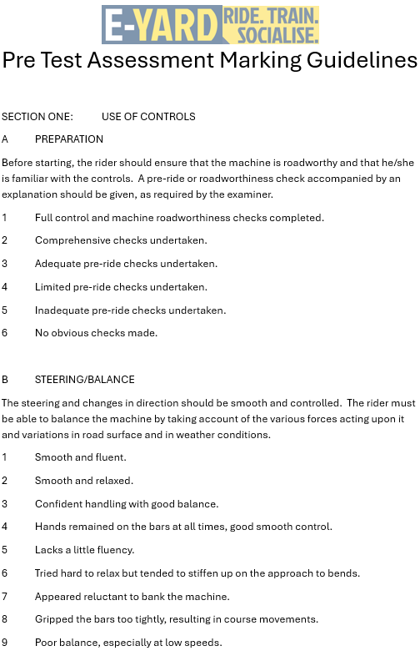
Pre Test Assessments
Pre Test Assessment Marking Guidelines document template can be found on the ‘Training Documents’ tab on the website.

Slide 50
THE
FATAL FIVE

Slide 51
Any Questions?

